Slide 1
C Programming Language Gopal Basak Semester – IV Department of Mathematics Nabadwip Vidyasagar College

Slide 2
Introduction of C
C is a general propose high level language which is developed for UNIX operating system.
C is a structured programming language which mean that allow us to develop program using designed control structure and develop modularity.
C is often called a middle level language because it combines the best element of low level language or machine level language with high level language.

Slide 3
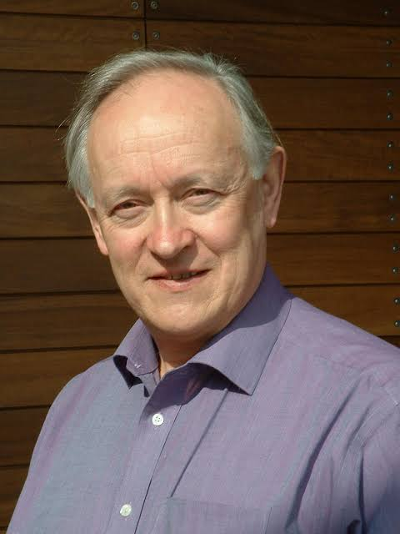
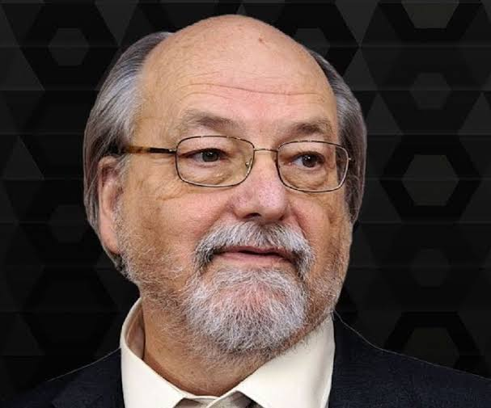
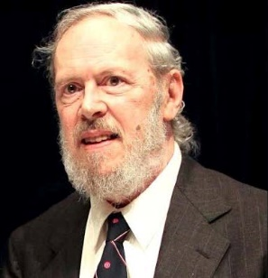
Historical Development of C
Language | Developed By
BCPL Martin Richard 1967 (at Cambridge University)
B Ken Thompson 1970 (at AT&T)
C Dennis Ritchie 1973 (at AT&T ,Bell Labs ,USA)

Slide 4
Year Developed By
ALGOL
1960 |  | International Committee
1963 |  | Cambridge University
1967 |  | Martin Richard
1970 |  | Ken Thompson
1973 |  | Dennis Ritchie
CPL
BCPL
B
C

Slide 5
Importance of C
C is a very simple language.
There is only 32 keyword so c is very easy to master.
C is structured language.
C is highly portable.
C is high level language.
C is also called mother of some most other language.
C is very fast execution speed.

Slide 6
C Token
Individual words and punctuation marks are called tokens. In C programs ,these tokens are called C tokens. C has six types of tokens :
C Token
Key Words
String
Special Symbols
Identifiers
Constants
Operators

Slide 7
Keywords:
Keywords are predefined, reserved words used in programming that have special meanings to the compiler. Keywords are part of the syntax and they cannot be used as an identifier.
Example : int, float, double, long, if, else, return etc.
Identifiers :
Identifiers refers to name given to entities such as variables, functions, structures etc. Identifiers must be unique.
Example : int money;
double accountBalance;
here money and accountBalance are identifiers.

Slide 8
Constant :
A constant is a value of variable that can’t be change in the program.
Example : π(3.14), e (2.72) etc.
Variable :
Variable are data values that can change when it need in program.
Example : a, b, c, x, y, z etc.
Special Symbols: #, %, &, ( ), /, { } etc.
Operators : + (Addition), - (Subtraction),
* (Multiplication), / (Division), % (Modulo division) etc.

Slide 9
Header File :
Some type of header file are given bellow
include<stdio.h> (Standard input output)
include<conio.h> (Console input output)
include<math.h>
Main Function :
Some type of main function are given bellow
int main()
float main()
void main()

Slide 10
Printf( ) :
It is mainly used for output. Whatever is inside printf( ) will be displayed on the screen.
Scanf( ) :
In a C programming scanf( ) is one of the commonly used function to take input from the user. The scanf( ) function reads formatted input fron the standard input such as keyboard.
%d :
%d is a format specifier used in C language. It represents the signed decimal integer values.

Slide 11
%f :
%f is a format specifier as %d. It is used for represent the functional (floating) values.
&(Ampersand) :
& function is used before the variable in scanf( ) function.
return(0) :
return(0) is used in C programming because it is a exit code of program. Where 0 means typically success of these program.

Slide 12
Syntax :
{
//printf(“Hello Everybody”);
}
Some example of programming :
Addition of two number :
#include<stdio.h>
int main()
void main()
{
int a, b, x;
printf(“Enter the value =”);
scanf(“%d%d” ,&a ,&b);
x=a+b;
printf(“Result =%d”, x);
return (0);
}
Output :
Hello Everybody
Output :
Enter the value =4
5
Result =9

Slide 13
Area of a circle :
#include<stdio.h>
int main()
void main()
{
float pi=3.24, x;
int r;
printf(“Enter the radius =”);
scanf(“%d”,&r);
x=pi*r*r;
printf(“Area =%f”, x);
return (0);
}
Output :
Enter the radius =5
Area =78.500000

