Slide 1

CRYPTOGRAPHY

Slide 2
What is Cryptography?
The term “Cryptography” comes from the Greek word “Kryptos" (that means hidden secret).
It is the practice and study of techniques for secure communication in the presence of third parties called adversaries.
More generally it is about constructing a secret message by prevented from the third parties or the public.

Slide 3
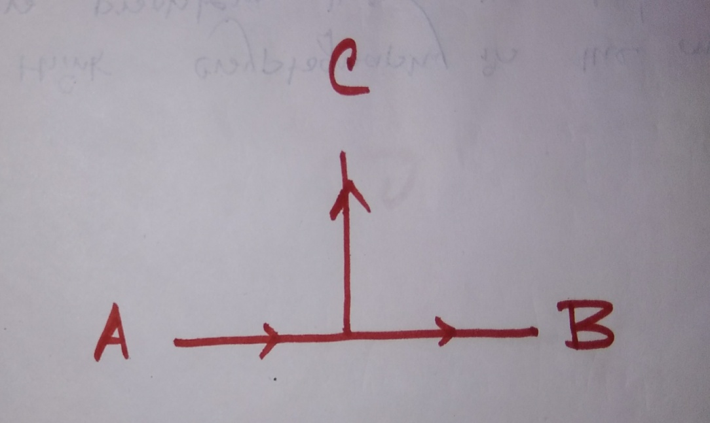
The Story
Suppose, A wants to send a message to B privately. But there C is also present to get the message. So A writes the message in a page and put it in a combination lock that is called Encryption.
Only A and B know the combination of the lock. So here B knows how to decrypt the encrypted message as B knows the Key. But as the process of breaking the combination is not known to C so he can't read the message. In this way A sends this message secretly to B, and that is called cryptography.

Slide 4
And..
More generally it is the science used to keep information secret and safe.
Modern cryptography is a mixture of Mathematics and Computer Science.

Slide 5
Process
When a message is sent using cryptography, it is changed (or encrypted) before it is sent. The method of changing text is called a code or more precisely; a cipher the change text is called Cipher Text. The change makes it hard to read. someone who wants to read decrypt it but other people should not be able to.
Studying the cipher text to discover the secret is called Cryptanalysis.

Slide 6
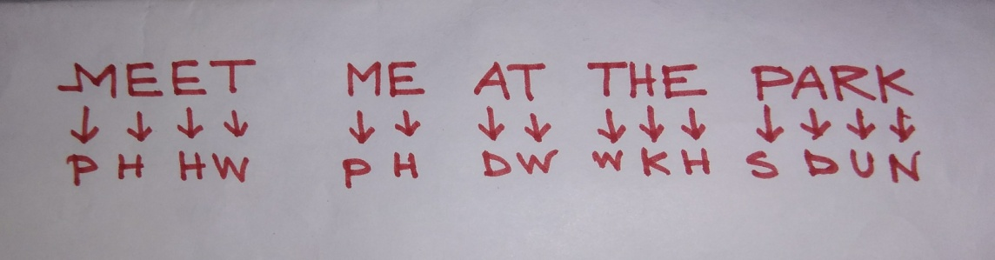
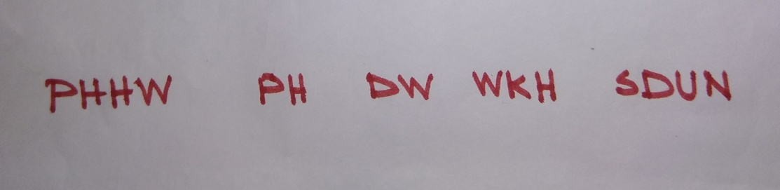
Caesar Cipher
The first well known cipher substitution cipher was used by Julio Caesar to send his militants secret message. Suppose he wants to write "MEET ME AT THE PARK" so what he did is that he wrote the word in a way that each of the letter is replaced by the third from itself say,
So the text of Caesar converted to:

Slide 7
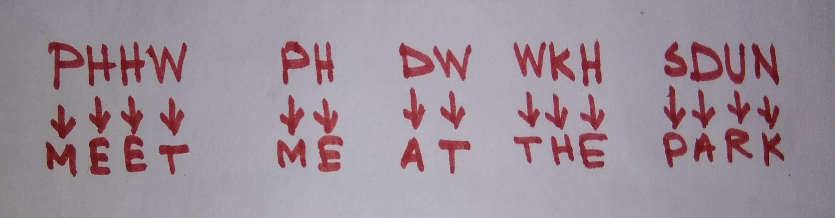
Interesting Part
That is useless for the third parties except the militants, as the militants know the substitution so they just did the opposite what Caesar did to read the message as :

Slide 8
And it went on..
In this way Caesar kept the messages secret.
But after 800 years., it was cracked by an Arabian mathematician by frequency analysis of the letter.
Then mathematicians started to do the encryption more securely.
The encryptions were done in many ways.
Say as using numbers, prime numbers, numbers and letters and prime numbers etc instead of this letters.

Slide 9
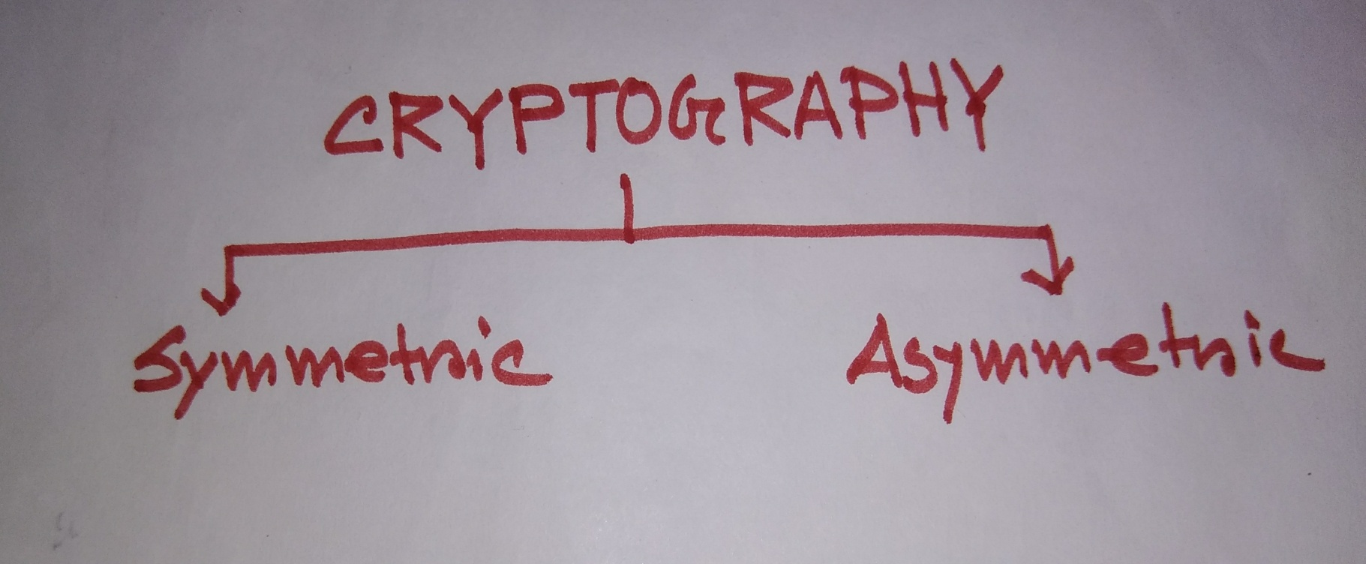
Are There Types?
Crypts are of two major types, namely Symmetric & Asymmetric.

Slide 10
SYMMETRYIC: In this type, both the user and receiver use the same key what the sender used to hide the message. The receiver uses the opposite key in way to reveal it. It is more widely used one.
ASYMMETRIC : It is harder to use. Each person who wants to use it uses a secret number (a private key) that is not shared and a different number. It is also used for computer signature. When a software company releases their updates for their software can sign those updates to prove that the updates were made by them. So that hackers could not make their own updates that would cause harm.

Slide 11
Who does?
Computer: As computers can calculate quickly, they can do strong encryption. E.g. computer algorithm like RSA, AES etc. In a good algorithm it is very hard to read the information that is sent.
PEOPLE : Men are very slow and therefore can hardly do beyond Caesar Cipher.

Slide 12
What’s its Importance?
It is used in ATM CARD, Online transaction, Net Banking etc.
There is also a crypto currency called Bit coin which is now very popular globally. It is a virtual currency based on cryptography.

Slide 13
"IF YOU THINK CRYPTOGRAPHY IS AN ANSWER TO YOUR PROBLEM, THEN YOU DON'T KNOW WHAT THE PROBLEM IS."

