Slide 1
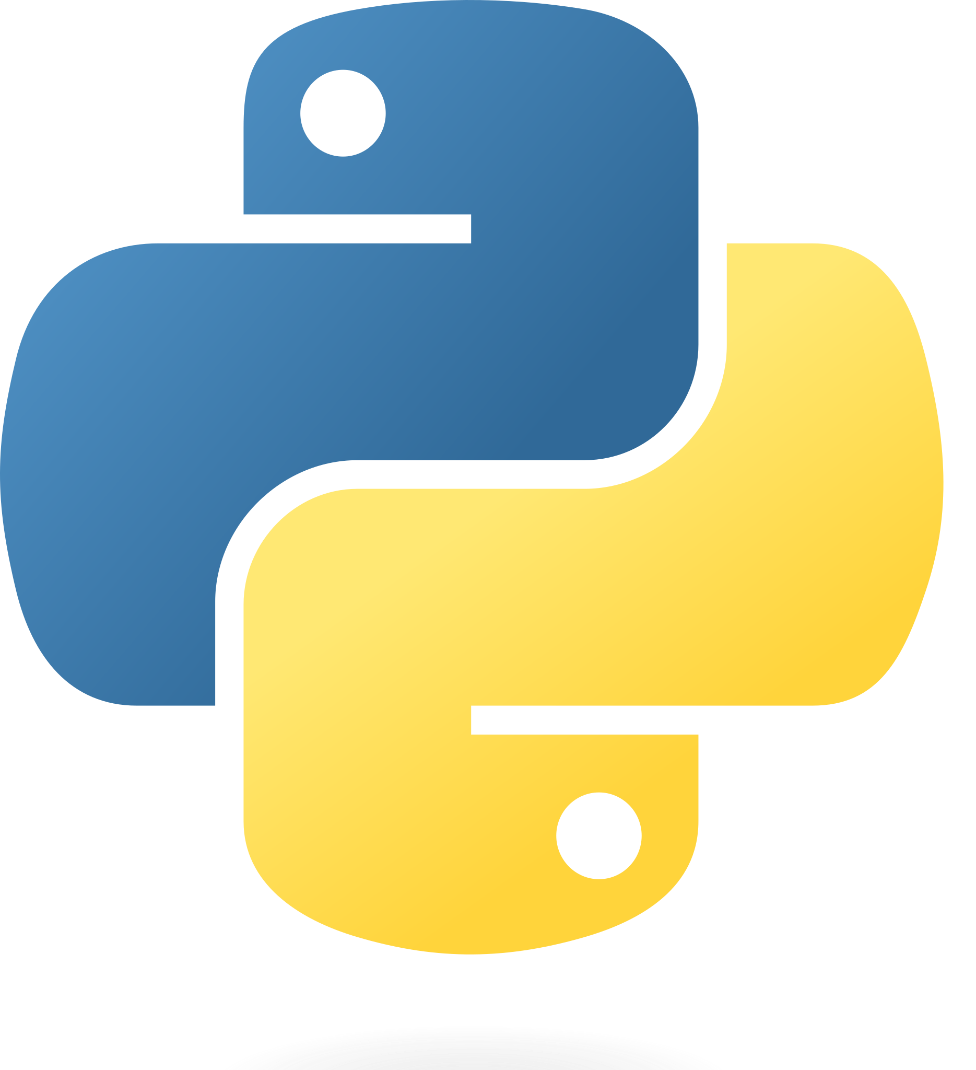
Computer Programming
& python

Slide 2

What is Computer Programming ?
A method based on which a computer perform tasks.
Let’s consider computer is a machine that has been designed similar to a human being.
Now if I want a human to do a task, what shall I do ?
Giving instruction
Understanding
Doing some calculations
Having some information in memory
Creative thinking & planning
Finally physical movement and some output

Slide 3
What is Computer Programming ?
Now if we want a computer to do a task, what do we do ?
Giving instruction
Storing information in memory
Doing arithmetic and logical operations
Output
Instruction can be given in various way. It is called INPUT.
One way is PROGRAMMING
PROGRAMMING
involves tasks such as analysis, generating algorithms, profiling algorithms' accuracy and resource consumption, and the implementation of algorithms.
No creative thinking

Slide 4
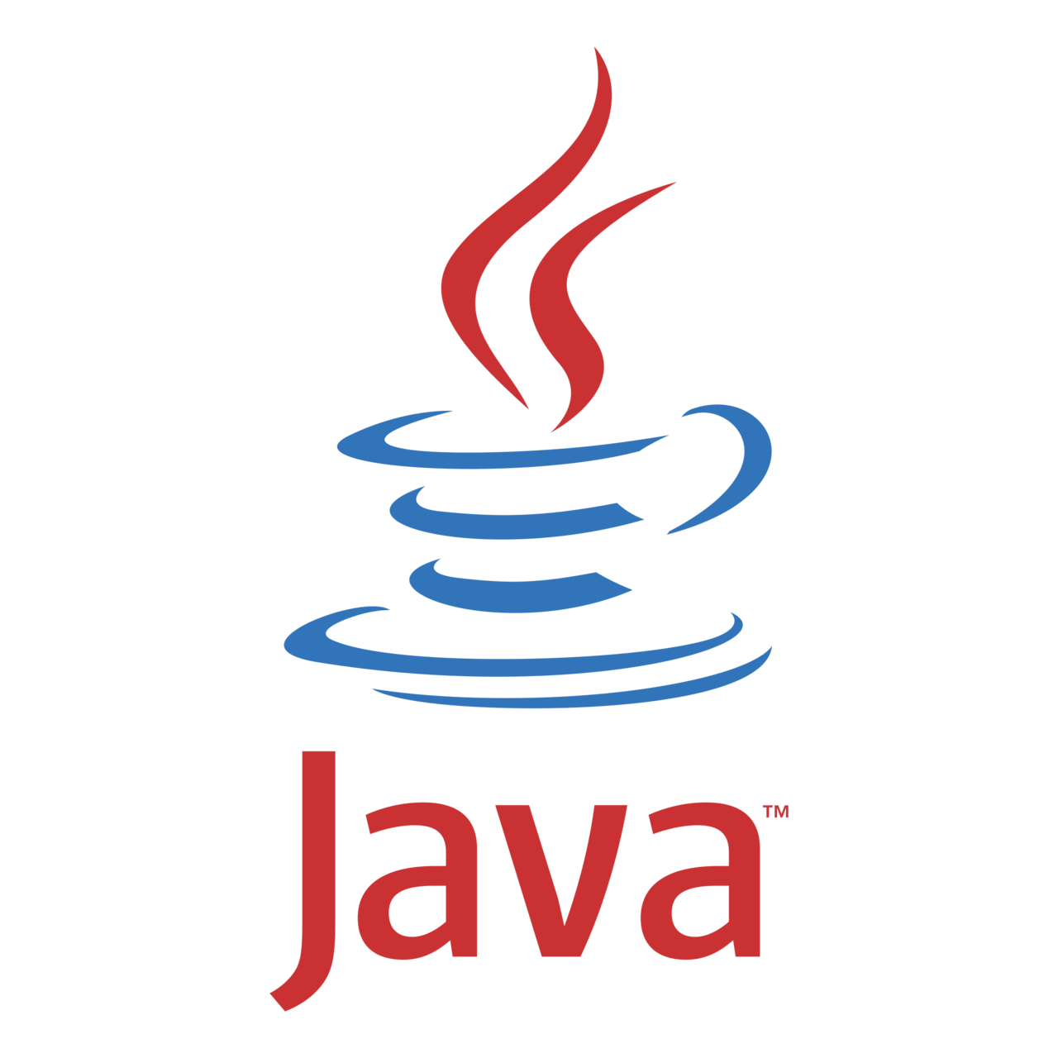


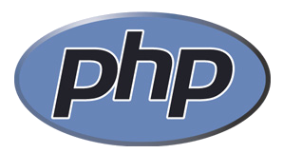
Some programming languages
and more…
What is python ?
Why python ?
It is a very popular programming language.
It is used for -
  web development (server-side)
  software development
  mathematics
  system scripting
  connecting to database systems
  reading and modifying files
  performing complex mathematics
Works on different platforms (Windows, Mac, Linux, Raspberry Pi, etc.).
simple syntax similar to the English language.
allows developers to write programs with fewer lines
Python prototyping can be very quick, meaning that code can be executed as soon as it is written

Slide 5
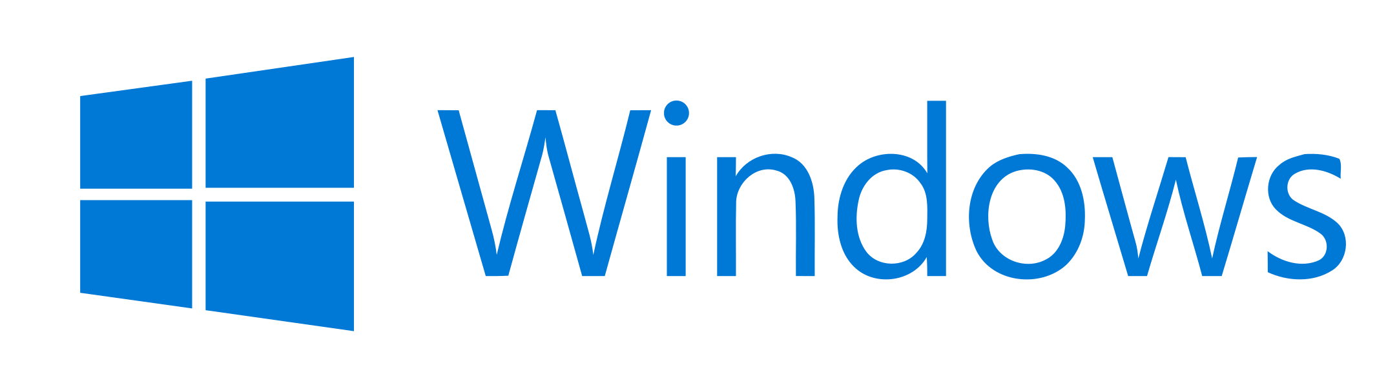
Get started with python
Python can be downloaded from the official website of PYTHON SOFTWARE FOUNDATION for various platforms (Windows, Linux, Mac, etc.).
https://www.python.org/downloads/
For today I am using WINDOWS operation system to understand python language and it’s practice.
After installing, python’s IDLE (Integrated Development and Learning Environment) will be available in Windows OS.
To check whether it is installed or not, open Command Prompt and type
python --version
After pressing enter, if the Command Prompt shows the version which is installed, our installation was successful.
Now our system is ready to perform python program.

Slide 6





Python Syntax
Python was designed for readability, and has some similarities to the English language.
Python uses new lines to complete a command.
Python Indentation is very important. It refers to the spaces at the beginning of a code line. Python uses indentation only to indicate a block of code.
Python comments. Comments start with a #
This line is not executed.
Python variables. variables are created when you assign a value to it.

Slide 7
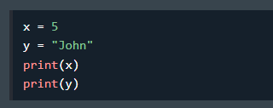
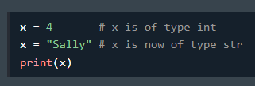
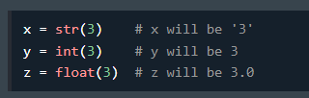
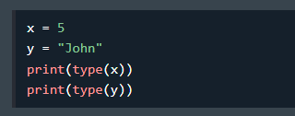
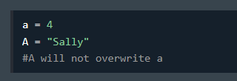
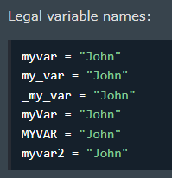
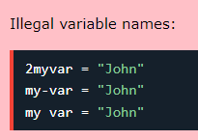
Python Variables
Python has no command for declaring a variable. A variable is created the moment you first assign a value to it.
Variables do not need to be declared with any particular type, and can even change type after they have been set.
Casting: If we want to specify the data type of a variable, this can be done with casting.
You can get the data type of a variable with the type() function.
Variable names are case-sensitive.
Variable Names:
A variable name must start with a letter or the underscore character.
A variable name cannot start with a number.
A variable name can only contain alpha-numeric characters and underscores (A-z, 0-9, and _ ).

Slide 8
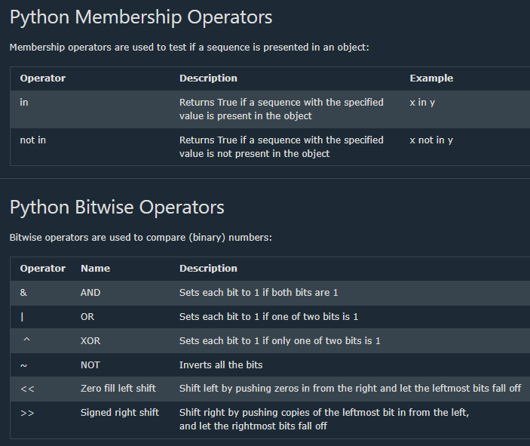
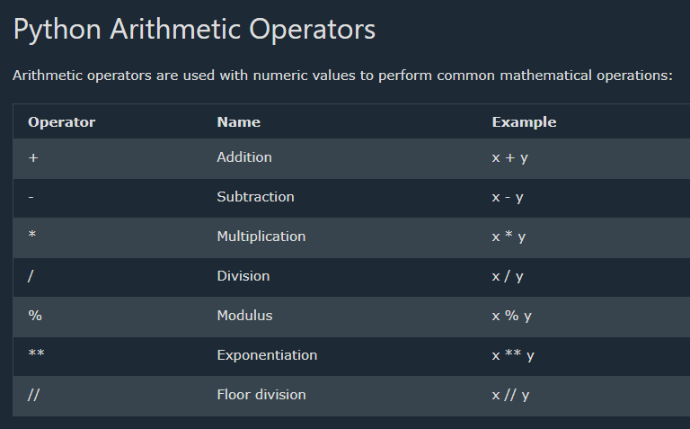
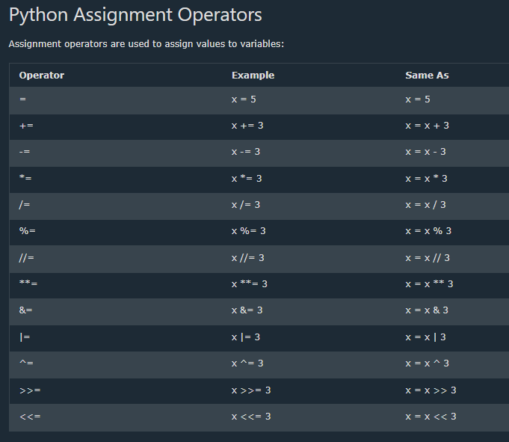
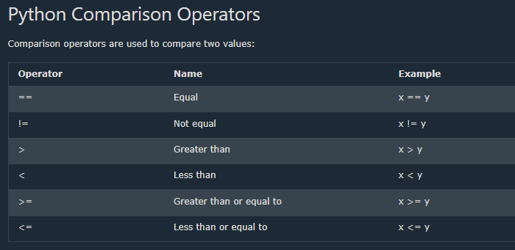
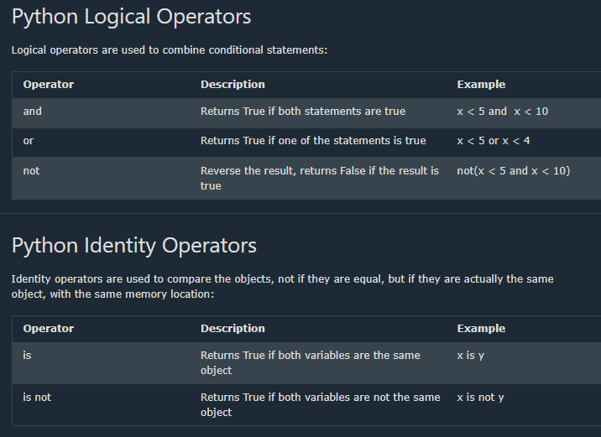
Python Operators
Arithmetic operators
Assignment operators
Comparison/Relational operators
Logical operators
Identity operators
Membership operators
Bitwise operators

Slide 9
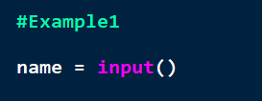
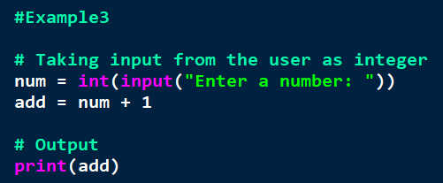
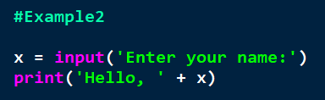
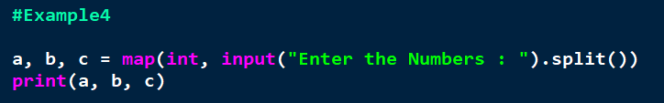
Input / Output statements in Python
This topic will introduce us to two inbuilt functions in Python input() & print().
We will learn the syntax of input() along with examples.
Then, we will learn various available arguments in print() and control the output format.
The input() function:
Is used to take input from the users

Slide 10
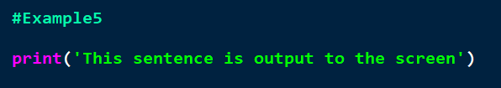
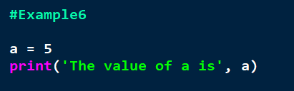
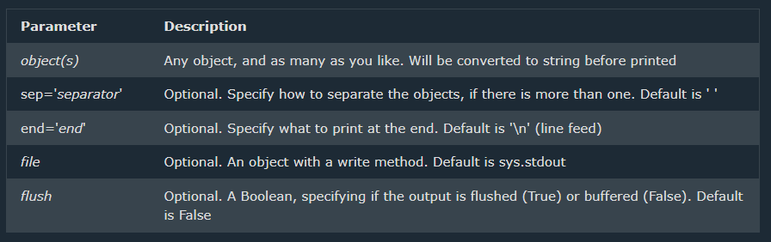
Input / Output statements in Python
The print() function:
Is used to show output to the user (to the standard output device).
We can also output data to a file, but this will be discussed later.
In the second print() statement, we can notice that space was added between the string and the value of variable a. This is by default, but we can change it.
The actual syntax of print() function is –
print(*objects, sep=' ', end='\n', file=sys.stdout, flush=False)

Slide 11
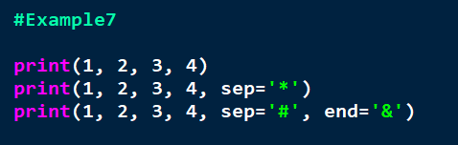
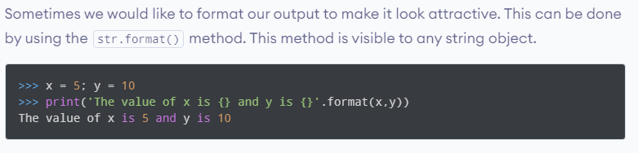
Input / Output statements in Python
Output Customizing & Formatting:

Slide 12
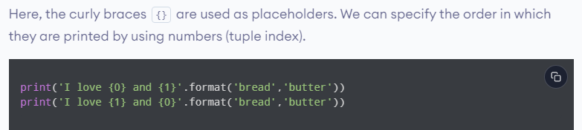
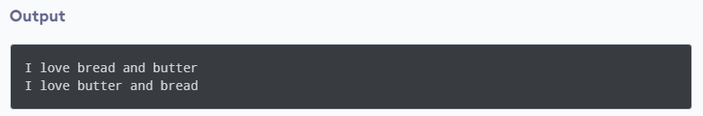
Input / Output statements in Python
Output Customizing & Formatting:

Slide 13
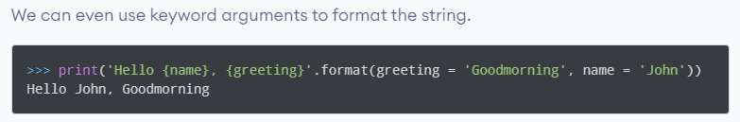
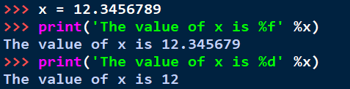

Input / Output statements in Python
Output Customizing & Formatting:
where,

Slide 14
Some Practices
Prac1: Adding two real numbers given by a user.
Prac2: Adding two complex numbers given by a user.
Prac3: Division of two real numbers, finding quotient, remainder and result.
Prac4: Solving a linear equation, ax + b = 0

Slide 15

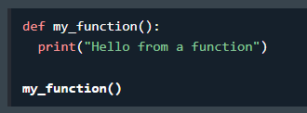
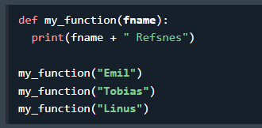
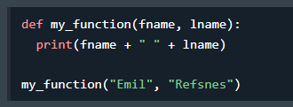
Python function
Defining a function
Calling a function
Arguments
Multiple Arguments

Slide 16
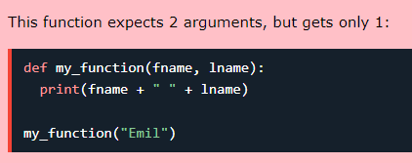
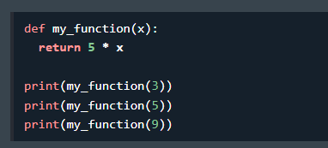
Python function
Argument error
Return values
Function Practice
Prac11: Adding two real numbers given by a user using python function.
Prac12: Arguments and return values example.

Slide 17
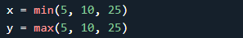


Python Math
Python has a set of built-in math functions, that allows you to perform mathematical tasks on numbers.
The min() and max() functions can be used to find the lowest or highest value in an iterable.
The abs() function returns the absolute (positive) value of the specified number.
The pow(x, y) function returns the value of x to the power of y.

Slide 18

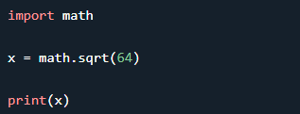
Python Math
The Math Module
Python has also a built-in module called math, which extends the list of mathematical functions. To use it, you must import the math module.
One Example
The math module has lots of mathematical methods and constants.
math.cos(), math.acos(), math.sin(), math.sqrt() and many more.
Python has a built-in module that you can use for mathematical tasks for complex numbers.

Slide 19
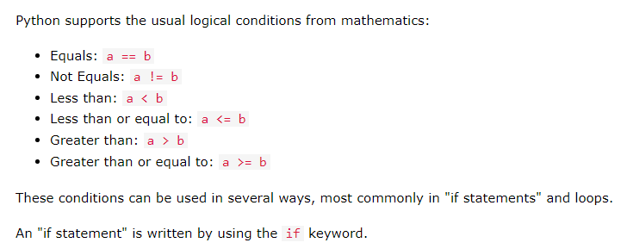
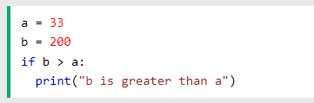
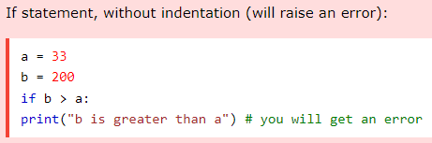
Python If…Else

Slide 20
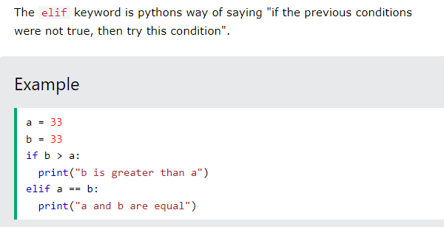
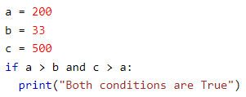
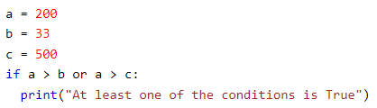
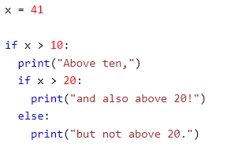

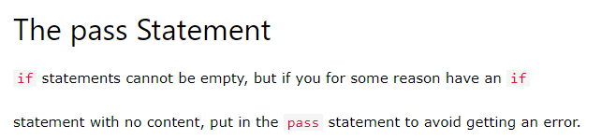
Python If…Else & multiple conditions

Slide 21

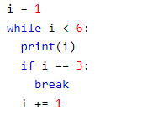
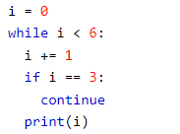
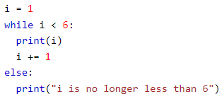
Python While Loops
With the while loop we can execute a set of statements as long as a condition is true.
With the break statement we can stop the loop even if the while condition is true.
With the continue statement we can stop the current iteration, and continue with the next.
With the else statement we can run a block of code once when the condition no longer is true.

Slide 22






Python Lists
Python Lists are used to store multiple items in a single variable.
List Items
List items are ordered, changeable, and allow duplicate values.
List items are indexed, the first item has index [0], the second item has index [1] etc.
Access List items
Add Item
Check if Item Exists
Insert Item at a specific index
Change Item value

Slide 23





Python Lists
Remove List Items
List Sorting
List objects have a sort() method that will sort the list alphanumerically, ascending, by default.
Remove specified Item by Index
To sort descending
List Length

Slide 24

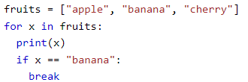

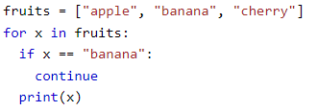
Python For Loops
A for loop is used for iterating over a sequence (that is either a list, array etc)
Like while loop we can use break and continue statement in this loop.
To loop through a set of code a specified number of times, we can use the range() function
Starting number
Ending number
Step

Slide 25
Some Practice
Prac21 : Factorial.
Prac22 : Find grade obtained by a student in a subject when mark is entered.
Prac23 : A student is eligible to take admission in College if he/she secured 80% in Mathematics and 85% in Physics. Write a program to check eligibility of the student after entering marks.
Prac24 : Bisection method of Solving a Nonlinear Equation.

Slide 26
print(“Thank You”)

