Slide 1
Seminar 2018
DEPARTMENT OF MATHEMATICS
NAME-DEBLINA CHOWDHURY
ROLL-94
TOPIC-SYSTEM OF CIRCLE

Slide 2
WHAH IS THE CIRCLE
A circle is a simple closed shape .it is the set of all point in a plane that are at a given distance from a given point ,the center equivalently it is the curve traced out by a point that moves so that its distance from a given point is constant. The distance between any points and the center is called radius. Circles are special ellipses that have a single constant radius around a center.

Slide 3
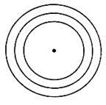
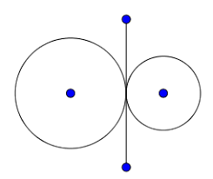
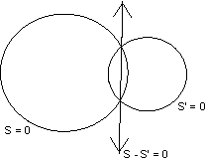
SYSTEM OF CIRCLE
System of circle is a family of circle.
Example:-
Definition:-Two circles are orthogonal when tangents at their common point are at right angle.

Slide 4
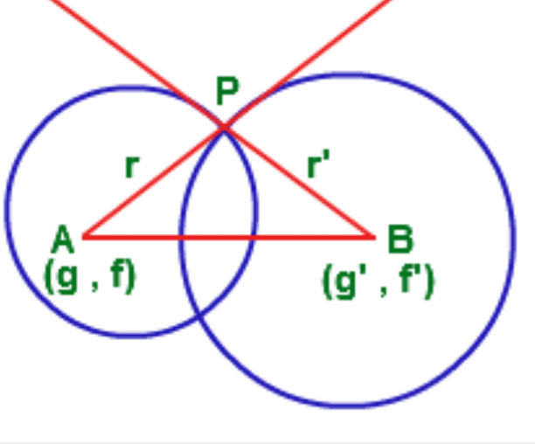
The equation of circle are
BP is tangent of circle and radius Of circle
AP is tangent of circle and radius of circle
1
1
2
2

Slide 5
So angle between AP and BP is right angle.
  So , APB =9O
  From APB
  AB = AP + BP
  Solve it
  This is the required equation.

Slide 6
POWER OF A POINT WITH RESPECT TO CIRCLE
R
T
Q
P
P be any point and circle is

Slide 7
The power of a point P is defined by distance of P from the point of intersection of any line which passes through P point and the circle .
The equation of line through P is
Here is angle which made by the line and x axis.
Here r is distance between and (x,y).

Slide 8
The intersection point between line and circle is
This point lies on circle

Slide 9
PT is length of tangent.
Power of p is square of length of tangent

Slide 10
THANK YOU

