Slide 1
Department of Mathematics
Departmental Seminar
Fibonacci Sequence & It’s Application
Presented By,
Diya Kansabanik
2nd Semester

Slide 2
What is the Fibonacci
sequence ?
The Fibonacci sequence, also known as Fibonacci numbers, is defined as the sequence of numbers in which each number in the sequence is equal to the sum of two numbers before it. The Fibonacci Sequence is given as: Fibonacci Sequence = 1, 1, 2, 3, 5, 8, 13, 21,….

Slide 3
What is the Fibonacci formula?
The Fibonacci formula is given as, Fn = F(n-1) + F(n-2), where n > 2. It is used to generate a term of the sequence by adding its previous two terms.
Example : F1=1,F2=1,F3=2,F4=3,F5=5,F6=8,F7=13,F8=21,F9=34,F10=55,F11=89,F12=144,….
Fibonacci of 8 –
The 8th number in the Fibonacci sequence is 21.
F8 = F8-1 + F8-2
= 13 + 8
= 21

Slide 4
Why are Fibonacci numbers important ?
Some traders believe that the Fibonacci numbers and ratios created by the sequence play an important role in finance that traders can apply using technical analysis.
A technical analyst looking for potential support and resistance levels will select two prominent points from a stock's chart, typically the highest and lowest points over a set period of time, and divide the vertical distance by key Fibonacci ratios.

Slide 5
What is Fibonacci golden ratio?
The golden ratio is an irrational number that is equal to (1+√5)/2,or approximately 1.618…
Example :
Fibonacci number | Divided by the one before | Ratio
5 | 5/3 | 1.66
8 | 8/5 | 1.60
13 | 13/8 | 1.62
21 | 21/13 | 1.61
34 | 34/21 | 1.61

Slide 6
Why do we use Fibonacci sequence?
The Fibonacci sequence is found in many different disciplines and in nature. For example , it has been used to describe plant life growth, estimate population increases over a specified timeframe, model virus breakouts, and predict the behavior of financial markets.

Slide 7
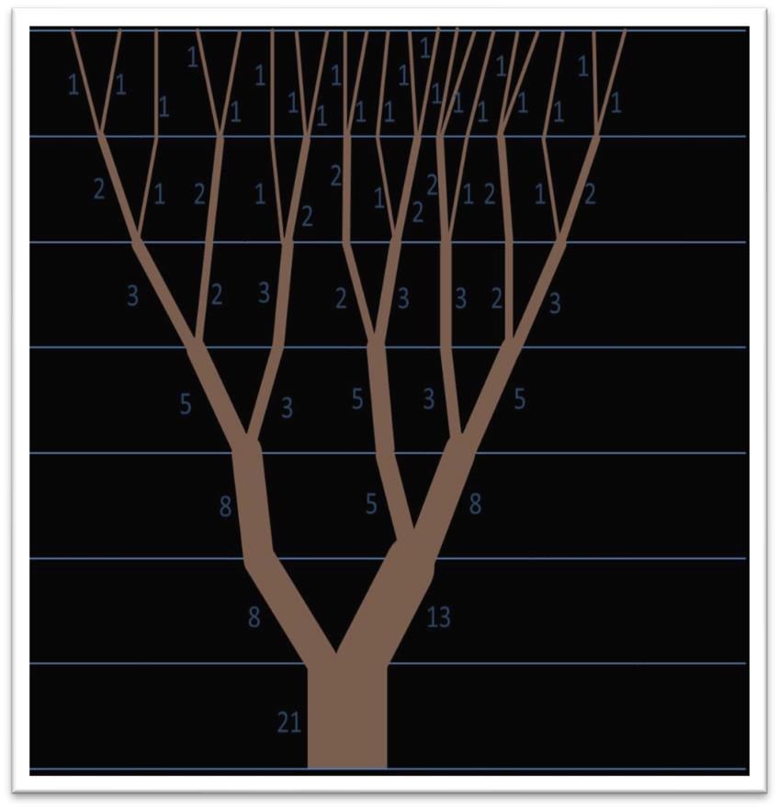
Example of Fibonacci sequence in real life
Tree Branches
Although we all usually see trees everywhere in our day to day life, how often have you looked for the patterns in them? In trees, the Fibonacci begins in the growth of the trunk and then spirals outward as the tree gets larger and taller. We also see the golden ratio in their branches as they start off with one trunk which splits into 2, then one of the new branches stems into 2, and this pattern continues. Fibonacci in nature - tree branches.

Slide 8
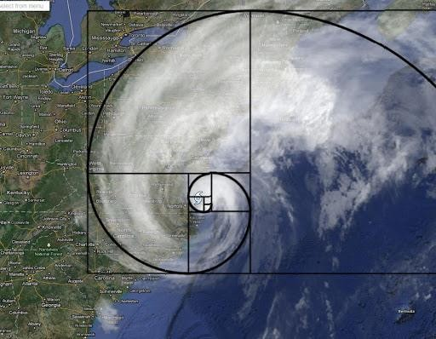
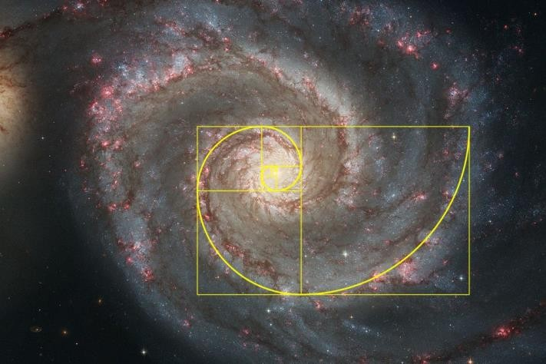
Example of Fibonacci sequence in real life
Seashells
When cut open, nautilus shells form a logarithmic spiral, composed of chambered sections called camerae. Each new chamber is equal to the size of the two camerae before it, which creates the logarithmic spiral. This proportional growth occurs because the nautilus grows at a constant rate throughout its life until reaching its full size. Fibonacci in nature – seashells.
Galaxies
The golden spiral can be found in the shape of the “arms” of galaxies if you look closely. It can’t be told if galaxies follow a perfect spiral, because we can’t measure a galaxy accurately, but on paper, we can measure it and see the size.

Slide 9
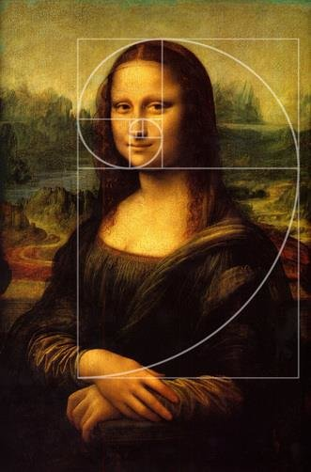
Example of Fibonacci sequence in
real life
Human
Human are an example of the beauty of the Fibonacci Sequence. The human body has various representations of the Fibonacci Sequence proportions, from your face to your ear to your hands. You have now been proven to be mathematically gorgeous. human face Fibonacci.

Slide 10
THANK YOU

