Slide 1
SEMINAR - 2018
DEPARTMENT OF MATHEMATICS
NAME- GOPAL DEBNATH
ROLL NO- 14
TOPIC- APLICATION OF CONICS

Slide 2
Some application of conics in our real life

Slide 3
Uses of parabola

Slide 4
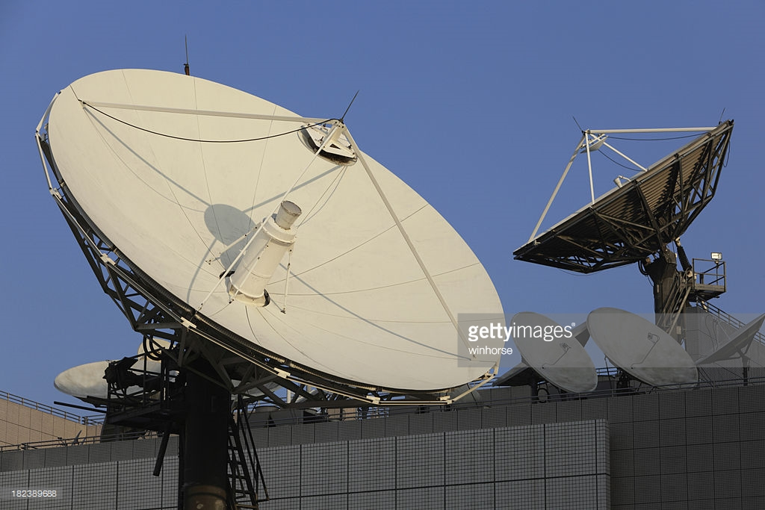

Slide 5
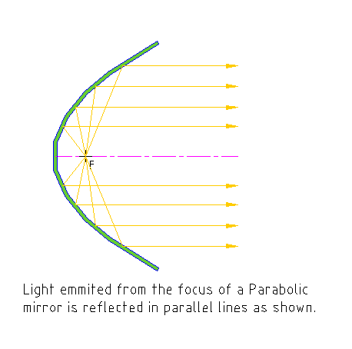

Slide 6
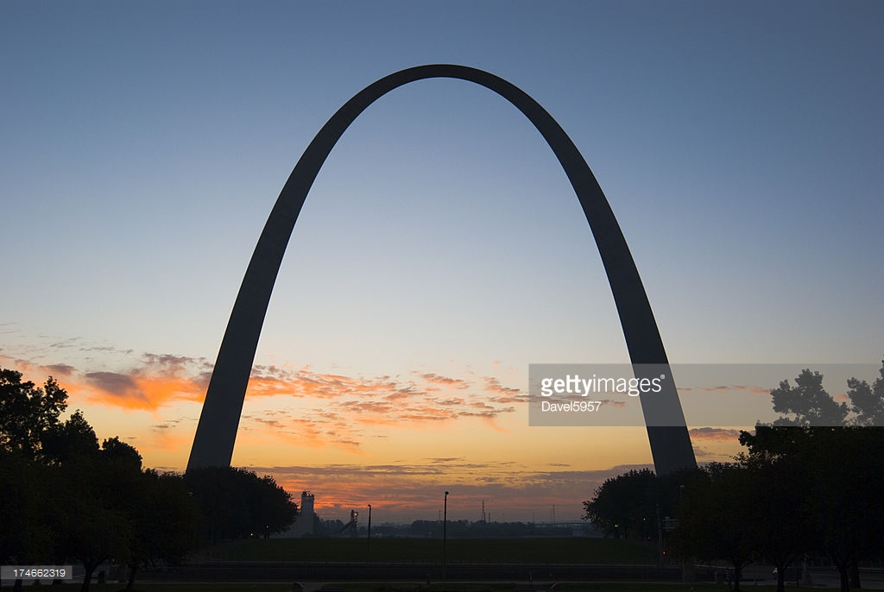

Slide 7


Slide 8
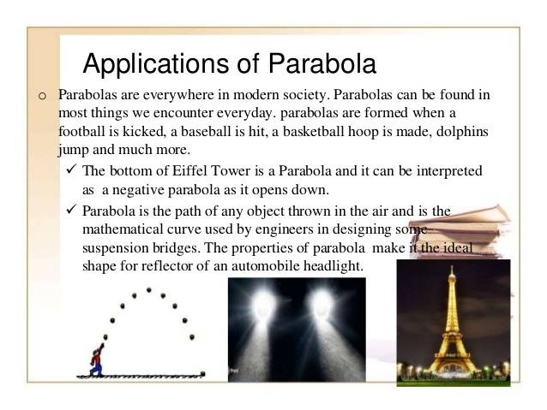

Slide 9
Uses of hyperbola

Slide 10


Slide 11
Uses of ellipse

Slide 12
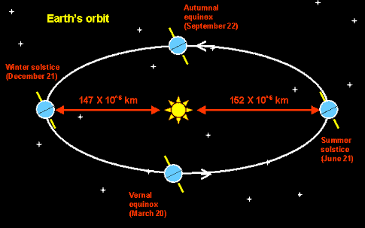

Slide 13
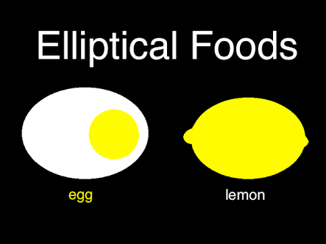

Slide 14
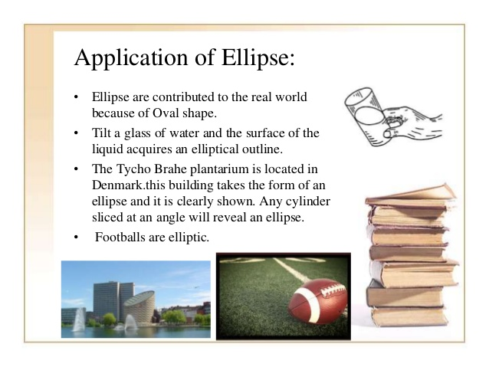

Slide 15
Uses of circle

Slide 16
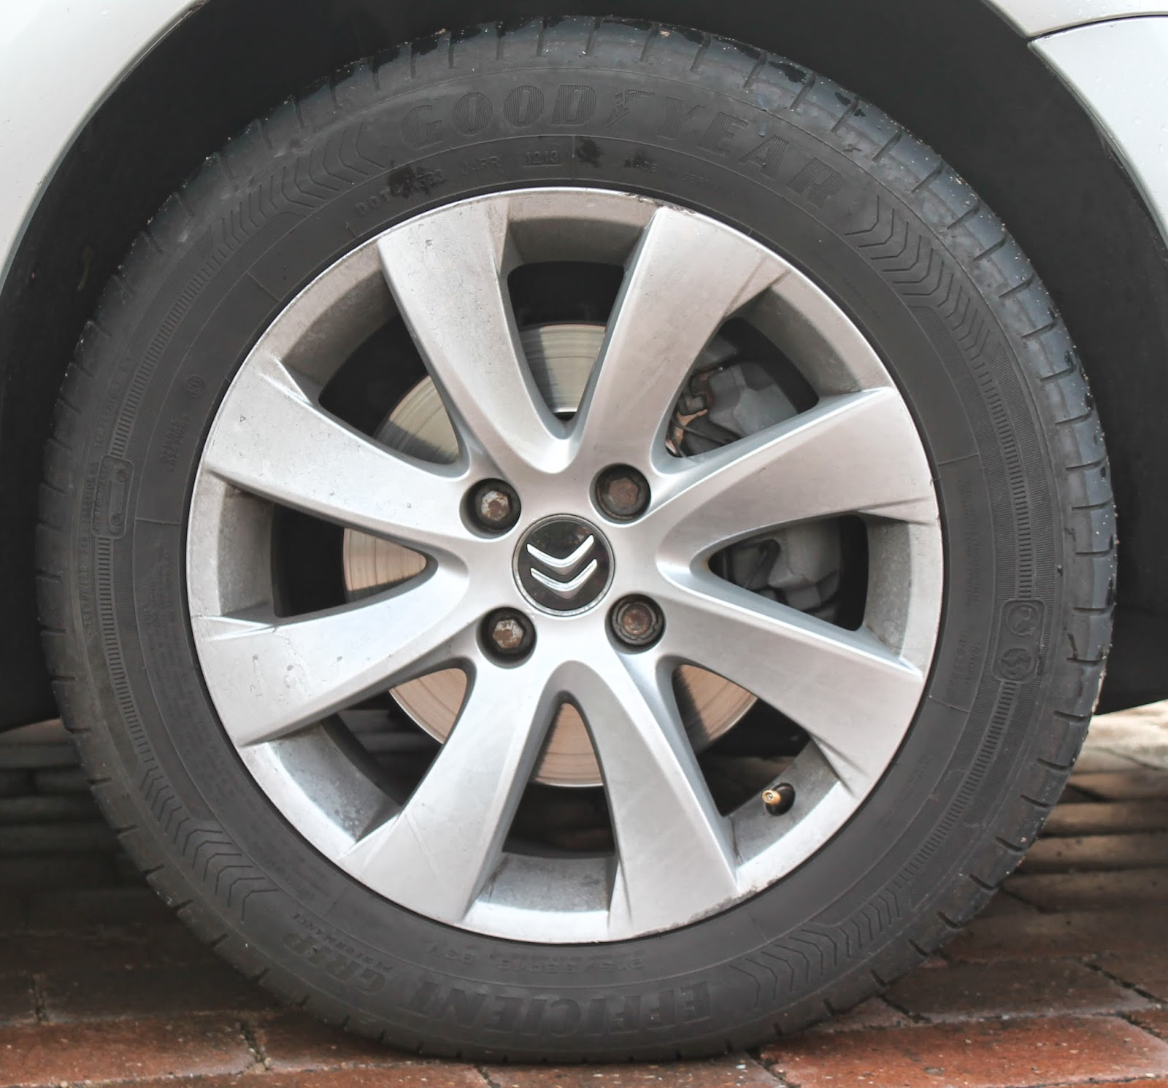

Slide 17
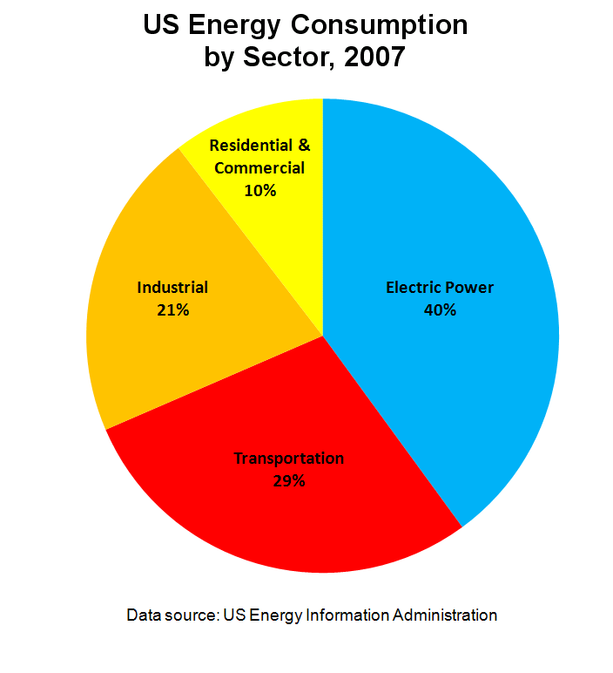

Slide 18
Thank you

