Slide 1
Presenting by Gopal Basak Semester-VI Department of Mathematics Nabadwip Vidyasagar College
Application of Mathematics in Different Fields

Slide 2
Outcomes:
What is Mathematics in simple words ?
What are the different applications of Mathematics?
Application of Mathematics in different fields.
How Mathematics play an important role in our lives?
How do we use Mathematics everyday?
What do we learn from Mathematics?

Slide 3
What is Mathematics in simple words?
Mathematics is the study of numbers, shapes and patterns . The word comes from the Greek word “μάθημα” (máthēma), meaning “science, knowledge or learning” . Numbers: How things can be counted.

Slide 4
Application of Mathematics in different fields:
Video Games: Here they learn about the different steps and techniques to be followed to win any game. Not only while playing, but the engineers who introduce different games for people also follow the different Mathematical concepts.
Applications:
Game Theory,
Probability,
Logical Reasoning.
Automobile Industry:
Basic Mathematical operations are being applied to gain knowledge about the different demands of the customers.
Applications:
Mathematical Operations,
Ratios and Proportions,
Statistics.
Computer Application:
The concepts like computation, algorithms, and many more forms the base for different computer applications like powerpoint, word, excel etc. are impossible to run without Mathematics.
Applications:
Computation,
Algorithm.
Planning A Trip:
We need to prepare the budget for the trip, the number of days, the destinations, hotels, adjusting our other work accordingly, and many more. Here comes the role of the Mathematics.
Applications:
Budgeting,
Algebra,
Calculus.

Slide 5
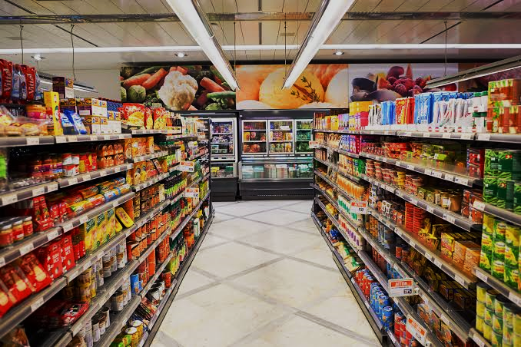
Sports:
Mathematics improves the cognitive and decision-making skills of a person. Such skills are very important for a sportsperson because by this he can take the right decision for his team.
Applications:
Probability
Mathematical Operations
Algorithm
Logical Reasoning
Game Theory
Travelling:
How much should be the speed to cover any particular distance?
How much time would be taken?
Whether to turn left or right?
When to stop the car?
When to increase or decrease the speed?
Applications:
Logical Reasoning
Numerical Reasoning
Grocery:
The schemes like ‘Flat 50% off’, ‘Buy one get one free’, etc. are seen on most of the stores.
Applications:
Mathematical Operations
Ratio and percentage
Algebra
Interior Design:
A lot of Mathematical concepts, calculations, budgets, estimations, targets etc. are to be followed to excel in this field.
Applications:
Geometry
Ratios and Percentages
Mathematical Operations
Calculus and Statistics

Slide 6
What are the different application of Mathematics?
Applied Mathematics is applying Mathematical techniques in various fields like enngineering, physics, medicine, business, biology, industry and computer science.

Slide 7
Most numbers that we work with every day are real numbers. These include all of the money that’s in our wallet, the statics we see in sports or the measurements we see in cookbooks. All of these numbers can be represented as a function (whether we like it or not).
How Mathematics play an important role in our lives?

Slide 8
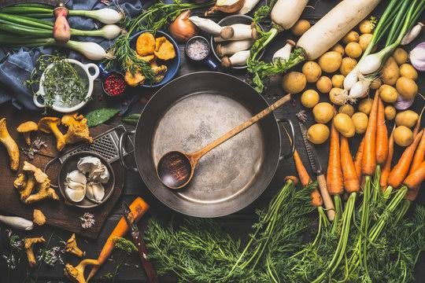
How do we use Mathematics everyday?
Date and Time:
We use calendar for finding the dates, months and years.
When we wake up, first we check out the time.
Mathematics is used for calculating date and time.
Cooking:
For making a perfect dish the ratio of ingredients is very important.
Mathematics used to measure quantity of various ingredients for a dish.
Money:
Mathematics is an unavoidable thing in the calculation of money.
In our daily life we use money for buying things and for various services.

Slide 9
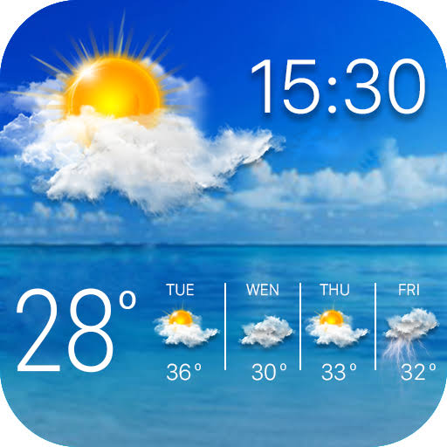
Banking:
Mathematics is used for banking purpose like loan, deposits, withdrawal of funds, interest and various other transactions.
Shopping:
Mathematics is used for shopping purposes also. Purchasing, billing, selling price, cost price, profit, loss, discounts, offers, tax etc. can be calculated only with the help of Mathematics.
Weather:
Mathematics is used for finding the temperature of a day.
It used for finding the speed of wind, annual rainfall etc.

Slide 10
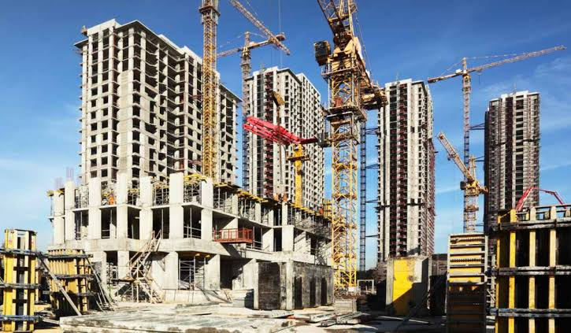
Medical Field:
Mathematics is widely used in medical field. We can calculate our blood pressure, heartbeat, temperature, dosage of medicine, various blood test etc. with the help of Mathematics. Various contents are used for making medicine. The ratio of the contents are very important.
Construction:
Mathematics is an unavoidable thing in construction field.
Here we need to find the area, perimeter, quantity of materials, height of the building, elevation etc.
Driving:
We can calculate the distance travelled, time taken for the journey, speed of the vehicle, fuel consumption etc. with the help of Mathematics.
We can see various Mathematical shapes used as road signs.

Slide 11
What do we learn from Mathematics?
Mathematics teaches us to think logically; to identify and state the problem clearly; to plan how to solve the problem; and then to apply the appropriate methods to evaluate and solve the problem. We learn to evaluate and draw conclusions based on our knowledge.

Slide 12
THANK YOU

