Slide 1
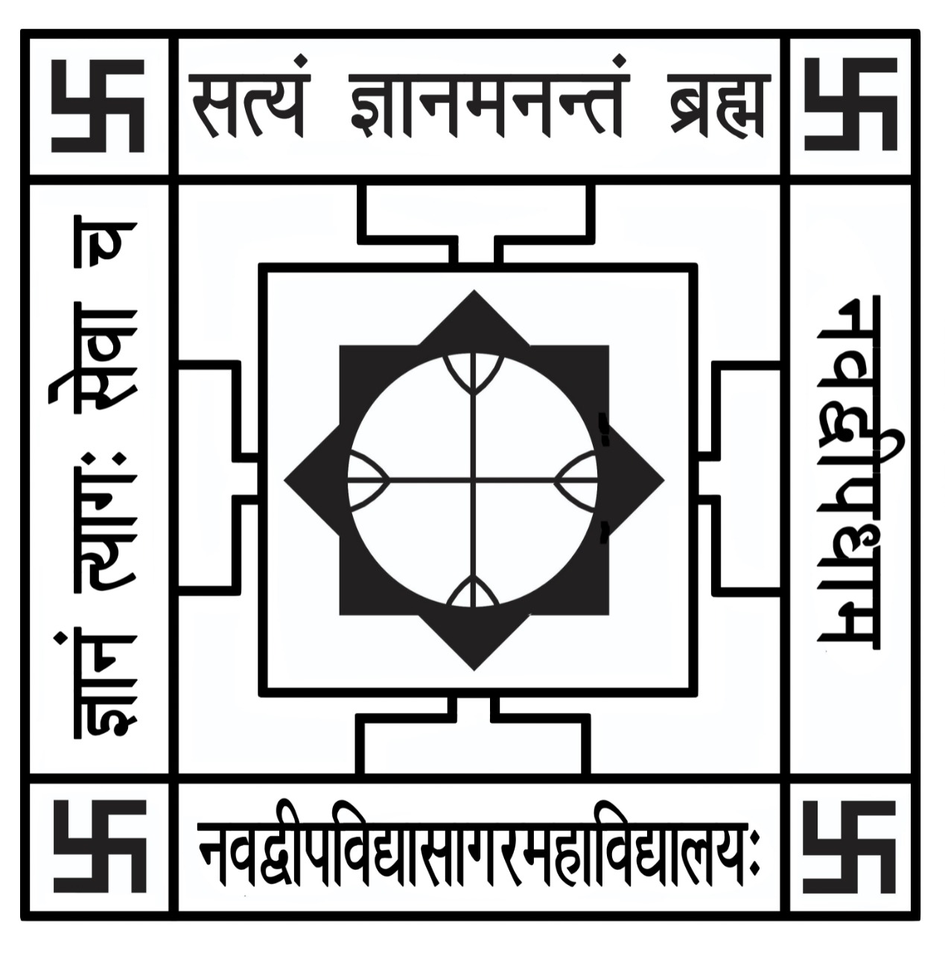
Department of Mathematics
Departmental Seminar
Vedic Mathematics
Manojit Basak
6th sem , Nabadwip Vidyasagar College

Slide 2
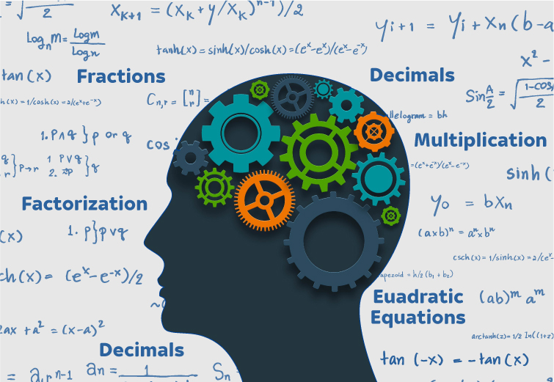
What is vedic Mathematics……….?
Vedic Mathematics is the name given to the ancient system of mathematics which was rediscovered by Vedas.
It’s a unique technique of Calculations best on simple principles and rules, with which any mathematical problem like in arithmetic, algebra, geometry, trigonometry can be solved mentally.

Slide 3
Why Vedic Mathematics …..?
It helps a person to solve problems 10 to 15 times faster .
It reduces burden.
It provides one line answer.
It increases concentration.
Logical thinking process get enhanced .

Slide 4
Sutras of Vedic Mathematics
Ekadhikina Purvena | By one more than the previous one
Nikhilam Navatashcaramam Dashatah | All from 9 and the last from 10
Urdhva-Tiryagbyham | Vertically and crosswise
Paraavartya Yojayet | Transpose and adjust
Shunyam Saamyasamuccaye | When the sum is the same, that sum is zero
(Anurupye) Shunyamanyat | If one is in ratio, the other is zero
Sankalana-vyavakalanabhyam | By addition and by subtraction
Puranapuranabyham | By the completion or non-completion
Chalana-Kalanabyham | Differences and Similarities
Yaavadunam | Whatever the extent of its deficiency
Vyashtisamanstih | Part and Whole
Shesanyankena Charamena | The remainders by the last digit
Sopaantyadvayamantyam | The ultimate and twice the penultimate
Ekanyunena Purvena | By one less than the previous one
Gunitasamuchyah | The product of the sum is equal to the sum of the product
Gunakasamuchyah | The factors of the sum is equal to the sum of the factors

Slide 5
Ekadhikina Purvena
The sutra ‘ Ekadhikina Purvena’ means By ‘one more than the previous one’
It is used for squaring of numbers ending to 5.
Conventional method
Vedic method
$65$
X65
+325
3900
4225
65X65=4225
(Multiply the previous
digit 6 by one more than
Itself 7.Then write 25.)
similarly,
95X95=9025

Slide 6
Nikhilam Navatashcaramam Dashatah
The sutra ‘Nikhilam Navatashcaramam Dashatah’ means by ‘All from 9 and the last from 10. ’
This formula can be very effectively applied in multiplications of numbers , which is are nearer to the bases like 10,100,1000 etc. ( for example 98x97etc.)
Case 1- when both the numbers are lower than the base
Conventional method
Vedic method
$97$
X94
+388
8730
9118
-
97 3
x94 6
91 18
x

Slide 7
Case 2- when both the numbers are greater than the base
Conventional method
Vedic method
$103$
X105
+515
0000
10300
10815
+
103 3
x105 5
108 15
x

Slide 8
Case 3- When one number is more and other is less than the base
Conventional method
Vedic method
$103$
X98
+824
9270
10094
-
103 3
x98 -2
100 (100-6)
100 94

Slide 9
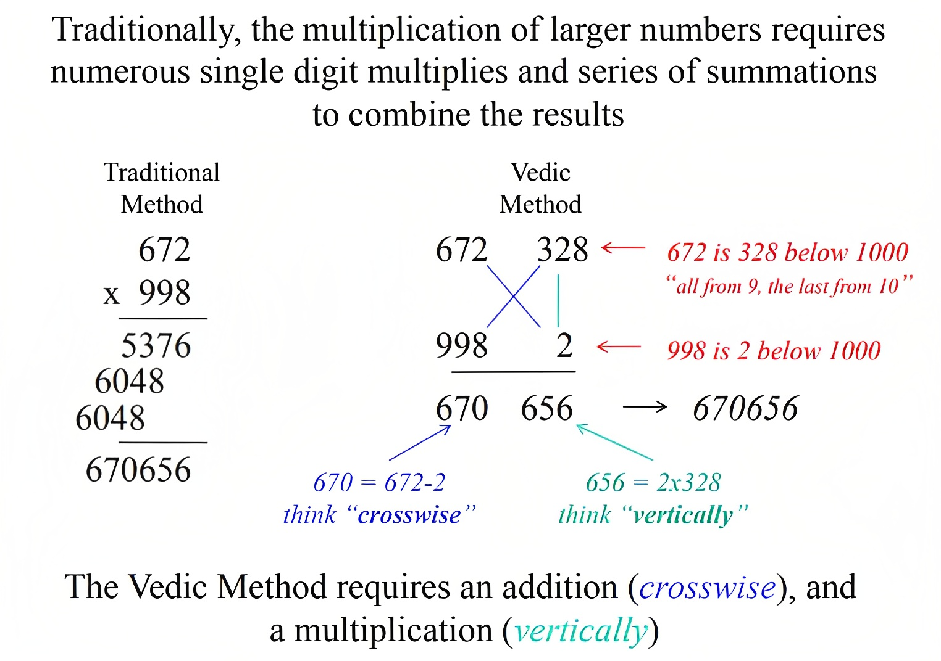

Slide 10
Now we will try more applications
Squaring a number
We all the formula (a+b)² = a² +2ab + b²
(4 2)² = 4² 2*4*2 2²
= 16 16 4
=1764
(11 4)² = 11² 2*11*4 4²
= 121 88 16
=12996
Carry over
(9 1)² = 9² 2*9*1 1²
= 81 18 1
=8281
Carry over

Slide 11
All the Perfect squares end in 1,4,5,6,9 or 0
And
Digit sums are 1,4,7 or 9
For example
4539
Ends in 9 but digit sum is 3
Therefore,4539 is not a Perfect square.
5776
Ends in 6 and digit sum is 4
Therefore,5776 is a Perfect square.

Slide 12
Multiplying by 11 can be perform easily
Conventional method
Vedic method
$45$
X11
+45
450
495
45
4 9 5
(Sum)
= 495
Carries Can be required when the sum exceeds 9
57
5 ₁2 7
(Sum)
= 627

Slide 13
Lets take another example ,
243x11
243
2 6 7 5
(2+4)
(4+3)
= 2675
Carries Can be required when the sum exceeds 9
561
5 ₁1 7 5
(2+4)
(4+3)
= 6171
Carry the 1 and added to 5

Slide 14
THANK YOU

