Slide 1
GOOD AFTERNOON EVERYONE !
MATHEMATICS AND MACHINE LEARNING
Ranjan Das,
6th Sem student of Department of Mathematics,
Nabadwip Vidyasagar College.

Slide 2
Mathematics is a very crucial part of our day-to-day life. From the day we born to death, we use mathematics knowingly or unknowingly in verious types of applications we used and in many scenarios.
Mathematics has gained a greater significance in the field of the latest technologies like- Machine Learning, Deep Learning, Artificial Intelligence and many more technologies. Every new technology in today’s world is directly or indirectly related to mathematics.
Introduction
Every algorithm built in the latest technologies has a mathematical function behind it. Mathematics helps to build logic behind every problem that we encounter in our day-to-day applications.
How is mathematics related to latest technologies ??
05/07/22 1 Ranjan Das

Slide 3
Application of mathematics in Machine Learning
Machine Learning is the science of getting computers to learn and act like humans do, and improve their learning over time in autonomous fashion, by feeding them data and information in the form of observations and real-world interactions.
What is Machine Learning ??
05/07/22 2 Ranjan Das

Slide 4
Application of Machine Learning
05/07/22 3 Ranjan Das

Slide 5
Foundation Pillars of Latest Technologies
The main concepts used in developing any type of new technology or solving any complex problem or discovering new algorithm are
1. Linear Algebra,
2. Calculas,
3. Probability,
4. Statistics.
We can say these concepts are the foundation pillars for enhancement of any latest technology or any new application in the real world.
05/07/22 4 Ranjan Das

Slide 6
05/07/22 5 Ranjan Das

Slide 7
Linear Algebra
Linear Algebra acts as a platform over which all the algorithms display results.
Linear Algebra makes possible for algorithms to run on massive datasets.
Linear Algebra can transform datasets into matrices on which operations can be performed. NumPy is such a library used in Machine Learning which performs several operations on N-d array.
05/07/22 6 Ranjan Das

Slide 8
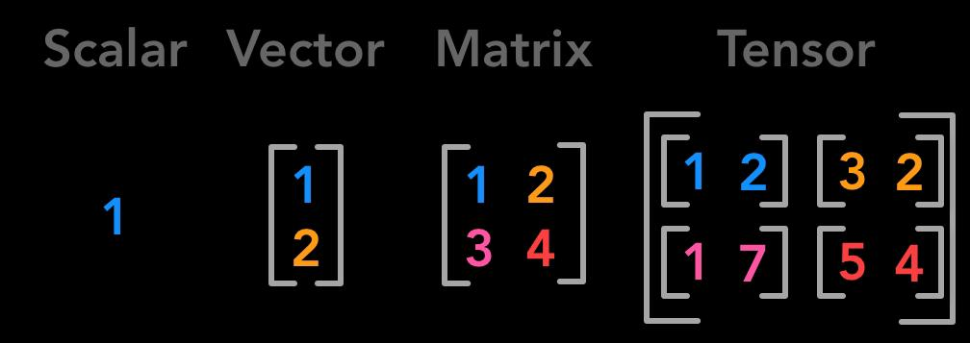
A Scalar is a single number.
A Vector is an array of numbers represented in a row or in a column.
A Matrix is a 2D array represented in rows and columns.
A Tensor is an N-dimentional array, with more values of n than 2.
05/07/22 7 Ranjan Das

Slide 9
Calculas
It is used to fine-tune the results.
Calculas plays an integral role in many Machine Learning algorithms like in gradient descent algorithm and backpropagation to train Deep Learning neural networks.
Calculas helps in the optimization of the models performance.
05/07/22 8 Ranjan Das

Slide 10
Cost Function refers to the functional relationship between cost and output. It is used to calculate how the model is performing. While building our Machine Learning model, our aim is to minimize the cost function.
It can be express as below:
C= f(Q) ;
Here C = Cost of Production,
Q = Quantum of output.
For Example,
05/07/22 9 Ranjan Das

Slide 11
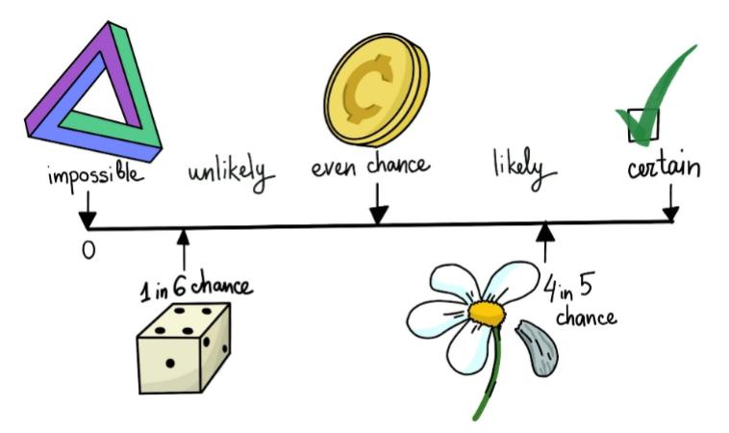
Probability
It deals with the likelihood of an event in a sample space and the certainty of that event.
Probability is mainly used in the latest technologies (Machine Learning, Deep Learning etc.), to produce better results for future prediction.
Probability helps in the decision-making aspect to bring out reliable results of a particular problem.
05/07/22 10 Ranjan Das

Slide 12
Naive Bayes Algorithm
The Naive Bayes algorithm is an example with a simple assumption that all the input features are independent.
05/07/22 11 Ranjan Das

Slide 13
Statistics
Statistics plays an important role in the field of the technologies to work on more complex data and acts as the mejor key factor behind the development and growth of an organisation.
It helps to draw insights from the data and also helps to transform sample observations into meaningful information.
Statistics deals with the collection, presentation, analysis and interpretation of numerical data.
05/07/22 12 Ranjan Das

Slide 14
Conclusion
For machine learning enthusiasts and aspirants, mathematics is a crucial aspect to focus on, and it is important to build a strong foundation in Math. Each and every concept in Machine Learning, every small algorithm to solving a problem directly or indirectly has a relation to Mathematics.
An understanding of math is paramount to enable us to come up with machine learning solutions to real world problems. A thorough knowledge of math concepts also helps us enhance our problem-solving skills.
Source: Internet
05/07/22 13 Ranjan Das

Slide 15
Thank You
05/07/22 14 Ranjan Das

