Slide 1
Graph Theory
Deepa basak
4th sem
Department of mathematics
Nabadwip vidyasagar college

Slide 2
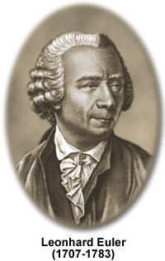
The great mathamatician and a
famous inventer of “Graph
Theory”.
Introduction
Graph is a object notation used to represent the
connection between pairs of object.
History of graph theory
Once,there was a city named Konig barg which is on pregel river.There was two island named Kneiphof and Lemos.They are connected with 7 bridges.In that time,a mathamaticians Carl Gattilieb Ehler, the mayor saw the 7 bridges and thought about it.

Slide 3
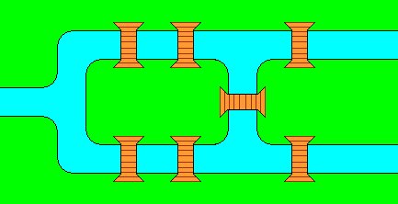
Konig barg
Kneiphof
Lemos
Pregel river

Slide 4
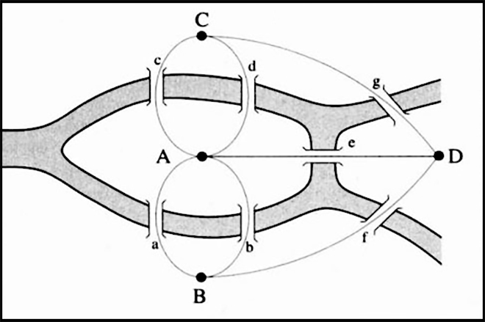
He thought that through which route we can cross each of the bridges once and only once . Then he wrote a letter to a great mathematician LEONHARD EULER about it. Seeing it, Euler rejected. Because he knew that there was no relation with math's . But he started thinking again about it. And thus he invented “GRAPH THEORY ” in 1735. And he specially created some graphs named “EULARIAN GRAPH ”. He presented islands as vertex . And he Showed bridges as edges.

Slide 5
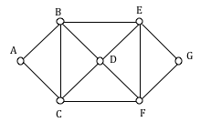
Now we learn what is eularian graph?
A connected graph g is eularian if there exists a close trail that includes every edges of g.
Example:
path:b e g f e d f c a b c d b

Slide 6
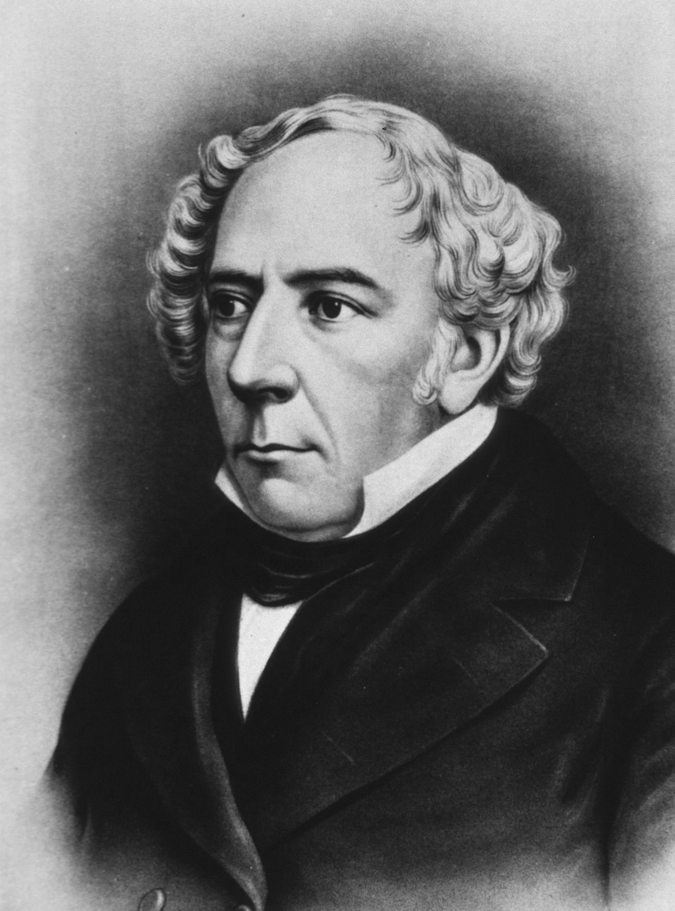
Hamiltonian graph:
In 1857,after Euler’s invent-
Ion ,sir Willian Rowan
Hamilton Invented a puzzle
Game Which involved hunt-
Ing For a Hamiltonian
Cycle.
So what is Hamiltonian Graph?
A connected graph g if there exists closed trail that covers every vertex.

Slide 7
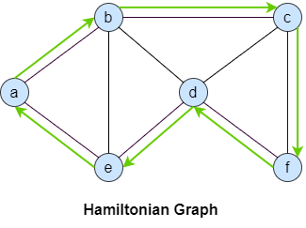
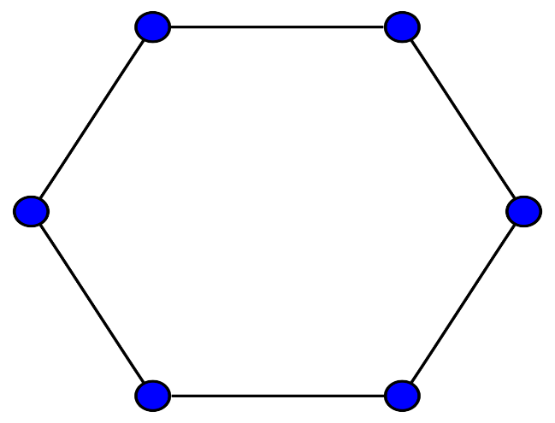
Example:
Path:a b c f d e a
Some special types of graph:
Type 1) cycle graph----
deg. Of all vertex- 2

Slide 8
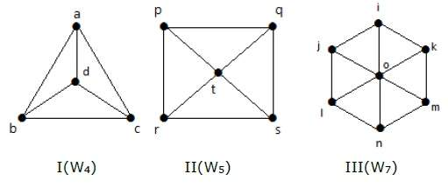
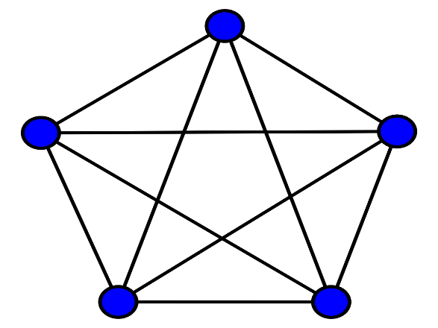
Type 2)wheel graph------
Degree of all
Vertex- 2(n-1)
Type 3)complete graph-----
Degree of all vertex-
Nc2
Type 4) null graph------
degree of all vertex- n

Slide 9
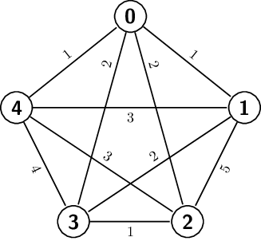
After it, we learn those related some theory problems like “Travelling Salesman Problem” and “Nearest Neighbourhood Problem”.
Example:
We take a graph at first like,
Travelling Salesman problem:
0 1 2 3 4 0
Therefore, 1+2+1+4+1=9
0 3 2 4 1 0
Therefore, 2+1+3+3+1=10
Nearest Neighbourhood problem:
0 4 1 2 0
Therefore, 1+3+2+2=8

Slide 10
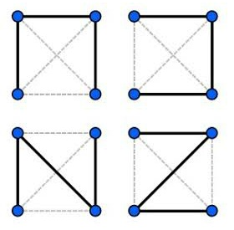
We now learn a type of graph named “TREE”.
SO,What is tree?
A connected graph with no cycle is called “TREE”.
EXAMPLE:
By “TREE”,we can learn about “SPANNING TREE”.

Slide 11
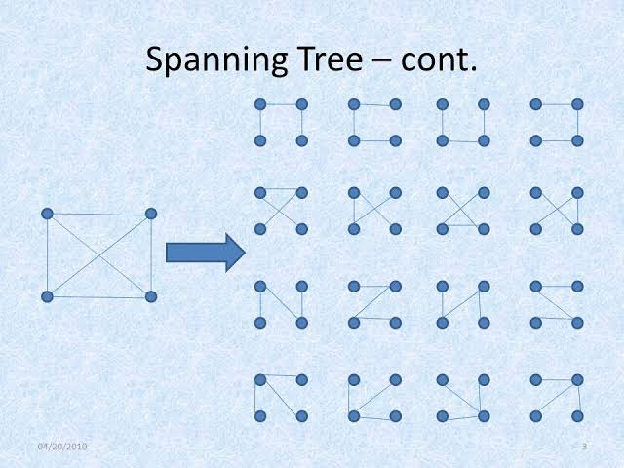
So, what is “Spanning Tree”?
Let,G be a graph with n vertices then any connected subgraph with no cycle and n vertices is called a “SPANNING TREE”.
Example:
We take K4 Graph in G and the spanning trees are----

Slide 12
Thank you

