Slide 1
DEPARTMENTAL SEMINAR-2018
TOPIC – PIE DIAGRAM
NAME – UJJWAL DAS
ROLL NO – 28
1st YEAR (2018)
DEPARTMENT OF MATHEMATICS

Slide 2
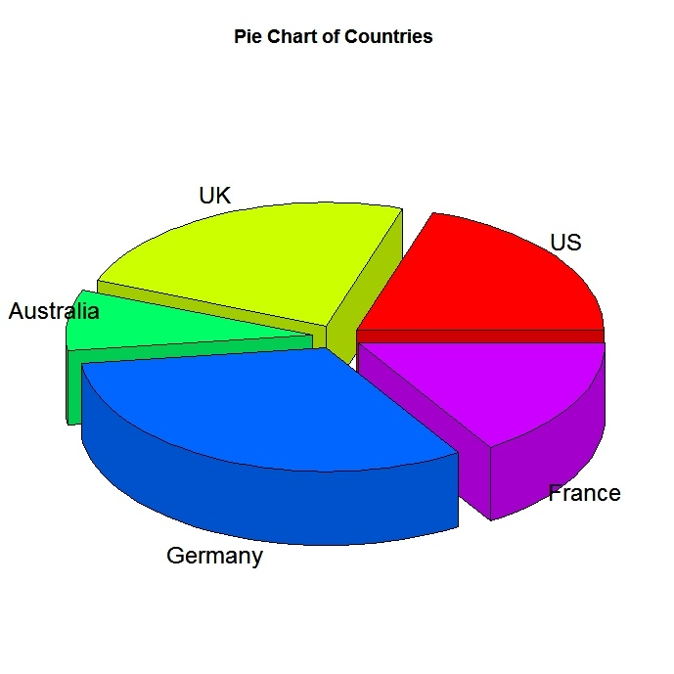
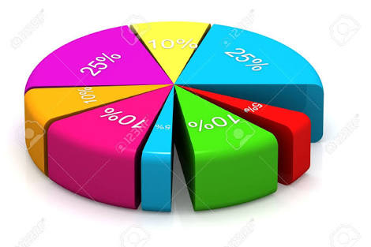
THE PRESENTATION OF PIE CHART OR PIE DIAGRAM

Slide 3
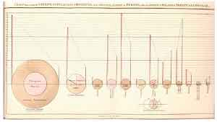
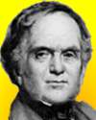
HISTORY OF PIE CHART
The pie chart diagram dates all the way back to 1801 when William Playfair produced a publication ‘The Statistical Breviary’ that contained the following pie diagram:-
The first ever pie chart was created by William Playfair over 200 years ago .

Slide 4
DEFINATION
A Pie Chart is a circular Statistical graphic which is divided into slice to illustrate numerical proportion .
The earlier known pie chart is generally credited to William Playfair’s Statistical Breviary of 1801.

Slide 5
Advantages of a Pie Chart
A Pie Charts presents as a simple and easy-to-understand picture . It can be an effective communication tool for even an uniformed audience .

Slide 6
CREATION OF A PIE CHART
We can create a pie chart according to the following process:-
Total
%
Degree
Arrange
Plot-Label
Kalyani University (2017) | No. of students | Percentage (%) | Degree
BA | 800 | 40% | 144*
B.SC | 600 | 30% | 108*
B.COM | 600 | 30% | 108*
Total | 2000 | 100% | 360*

Slide 7
EXAMPLE : -

Slide 8
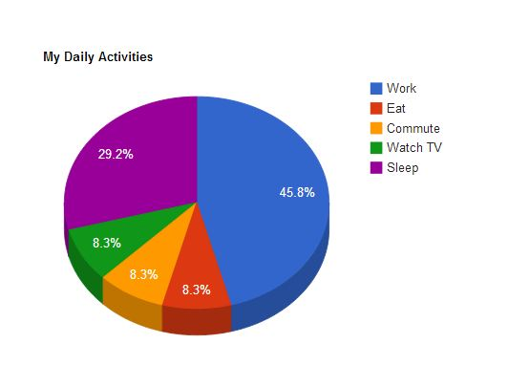
USES OF PIE CHART
The main use of pie chart is to show comparison . Various application of pie charts can be found in business , school, at home.
I can use pie charts to show my daily activities.

Slide 9
Many uses of pie chart are given below:-
For business , pie charts can be used to show the success or failure of certain products of services.
It can used in a test cricket match to show the comparison of the session’s win percentage

