Slide 1
SEMINAR 2018
NAME:-ANKITA ROY
ROLL:-60
TOPIC:-SYSTEM OF CIRCLES
DEPARTMENT OF MATHEMATICS

Slide 2
RADICAL AXIS
Definition-The radical axis of two circle is the locus of a point which moves in such a way that the length of tangent drawn from it to the
circles are equal.
Let P(h,k)be a point whose powers w.r.t (1) and (2) are equal.

Slide 3
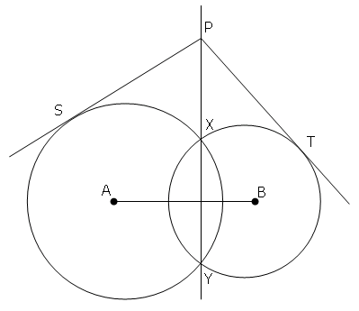
The gradient of radical axis is =
The gradient of the line joining the centre of two
circle=

Slide 4
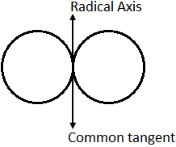
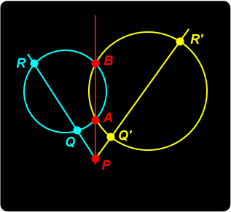
The product of two gradient is=-1
If the two circles intersect then the radical axis is the common chord as in fig 1

Slide 5
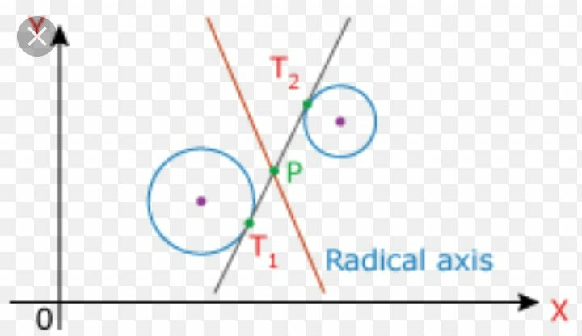
If the two circles touches one another then the radical axis is a common tangent
If the two circles don’t intersect each other then the radical axis will be perpendicular to the line joining the centre’s
Also the radical axis of two circles bisects their common tangent

Slide 6
We get three radical axis and the equation’ s are,

Slide 8
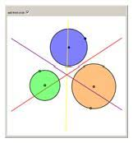
so the lines are concurrent .
Adding equation 3, 4, 5
Radical centre :-The point of intersection of any two radical axis is called redical centre .

Slide 9
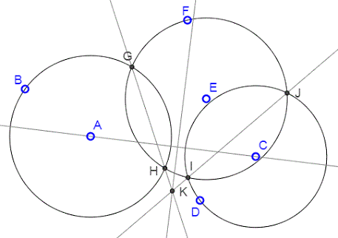
If two circles cut a third circle orthogonally , then the centre of the circle lies on the radical axis of the first two circles

Slide 10
COAXIAL CIRCLES
Definition -:A system of circles is said to be coaxial if any two of them have the same radical axis .
And

Slide 11
Is the equation of a straight line ,then
Represents the equation of a coaxial system with as a parameter.
In this system is the radical axis ,
The coordinates of the centre are

Slide 12
And radius
The circle whose radius is zero is known as a point circle .In a coaxial system the centre of the point circles are called limiting points.
and

Slide 13
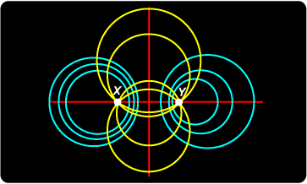
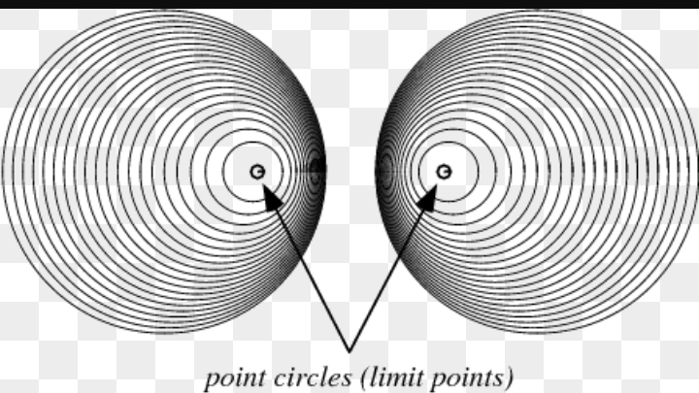

Slide 14
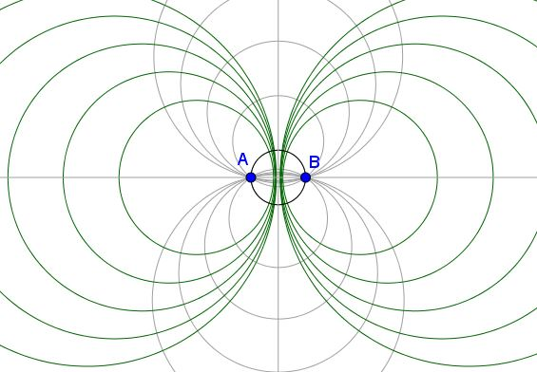
If and be the equation of two circles in the coaxial system ,then
Is the equation of the coaxial system .

Slide 15
APPLICATION OF CIRCLES IN DAILY LIFE

Slide 16
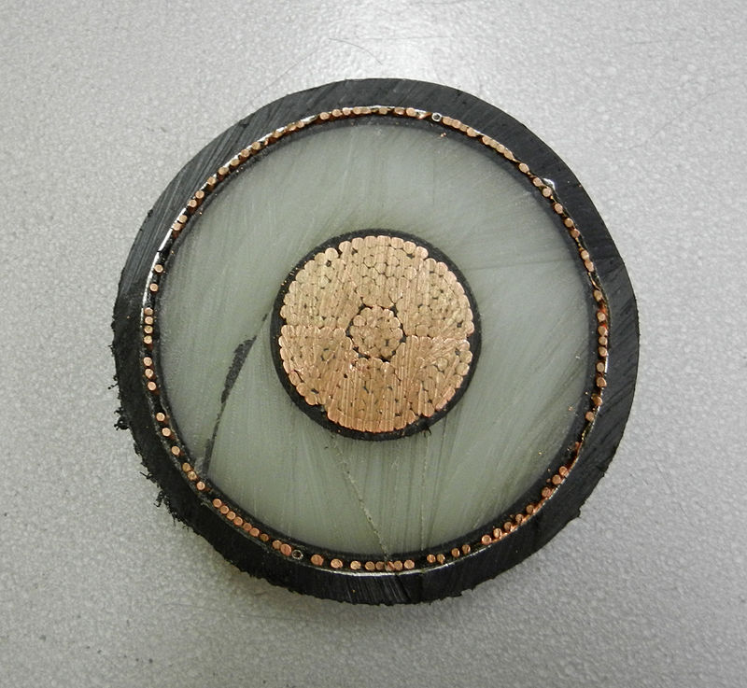
USES OF COAXIAL CIRCLES IN COAXIAL CABLES (CROSS SECTION)

Slide 17
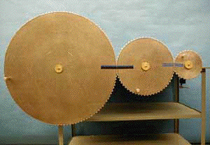

Slide 18
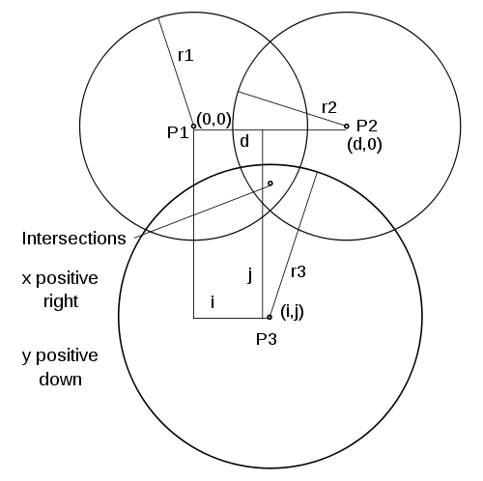

Gps calculating

Slide 19
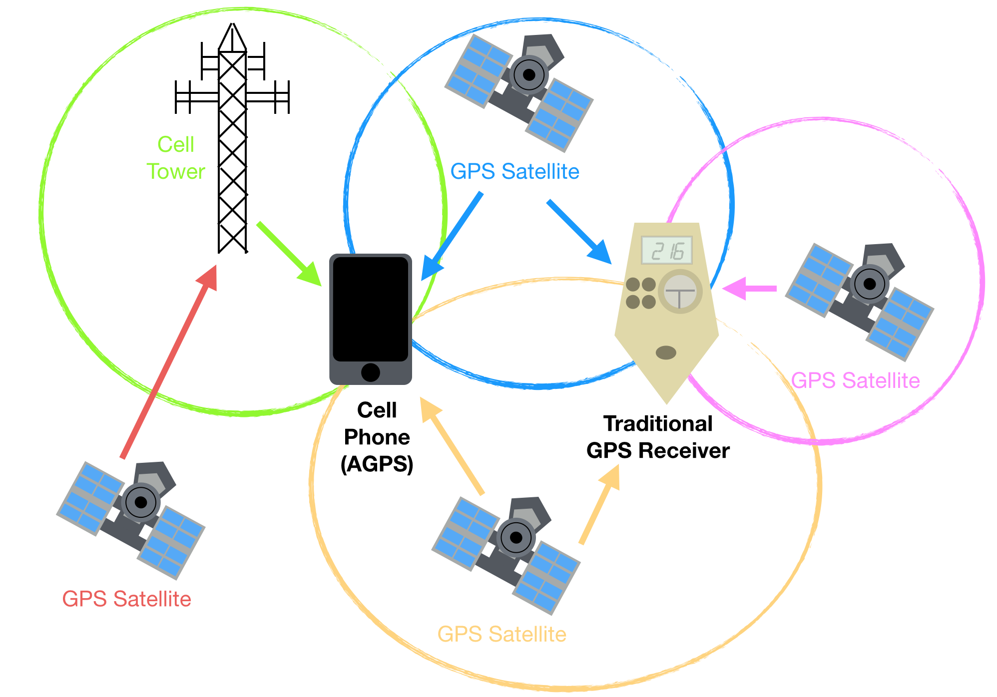

Slide 20
THANK YOU

