Slide 1
infinity
(which never ends)

Slide 2
intro
INFINITY is a concept in maths and philosophy that refers to a quantity without bound or end. People have developed various ideas throughout history about nature of infiniity . While some people conceptualize infinity as a number but it is not treated as a number in maths. German mathematician GEORG CANTOR formalized many ideas during late 19th and 20th centuries.
∞

Slide 3
Lets dive to old days of this concept

Slide 4
History
Ancient Indians and Greeks , being unable to codify infinity in terms of a formalized mathematical system approached INFINITY as a philosophical concept.

Slide 5
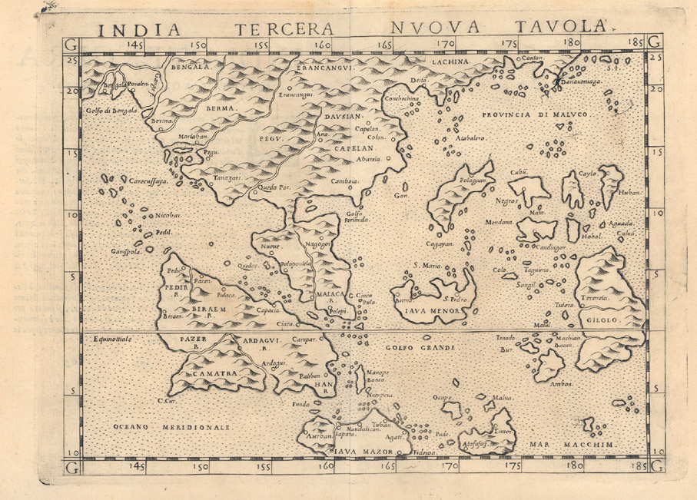
What Indian did think about infinity?

Slide 6
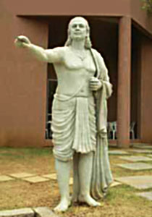
Early indian views on infinity
The ISHA UPANISHADA of YAJURVEDA states that “If you remove a part from infinity, still what remains is infinity.” The Indian mathematical text SURYA PRAJNAPTI classifies all numbers into three sets: enumerable ,innumerable ,infinite and infinite was three types : nearly infinite, truly infinite and infinitely infinite. The Jains were first to discard the idea that all infinities are same . They also defined a whole number system of infinite cardinal numbers ; of which the highest enumerable number N is smallest.
infinite
Nearly infinite
Truly infinite
Infinitely
infinite
Numbers
Enumerable
Innumerable
Infinite

Slide 7
EARLY GREEK VIEWS
The Hellenistic Greeks generally preferred to distinguish the potential infinity from the actual infinite.Instead of saying that there are an infinity of primes, Euclid prefers instead to say that there are more prime numbers than contained in any given collection of prime numbers.

Slide 8
MORE INFORMATION
1. POSITIVE AND NEGATIVE INFINITY Positive infinity symbol is a variable with a value that is larger than any other positive numbers , in case of negative infinity , it is larger than any other negative numbers. 2. 1,2,3,…… the sequence of natural number never ends, it is infinite but 1/3 is finite it is not infinite 3. Infinity does not grow as it is already fully formed. 4. Infinity is not a real number , it is an idea of something without any end.

Slide 9
Infinity is simple
Infinity is simple because it has no end so we don’t need any extra information to define where it ends. EXMPLE : In geometry a line has infinite length , if it has one end it is called ray , if there is two end its called LINE SEGMENT which needs extra information to define where it ends. . * A GOOGOL is already bigger than the number of elementary particles in the known universe . Even faraway galaxies cannot complete with infinity.

Slide 10
SPECIAL PROPERTIES OF INFINITY
WE CAN DEFINE
UNDEFINED OPERATIONS.
0 *∞ 0* -∞ ∞+-∞ ∞-∞ ∞/∞

Slide 11
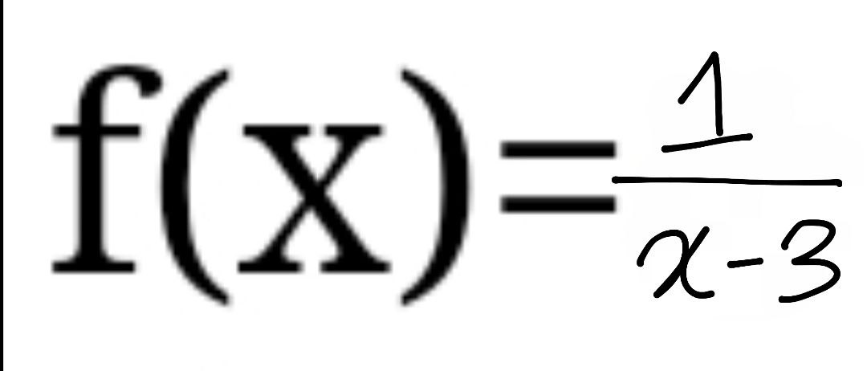
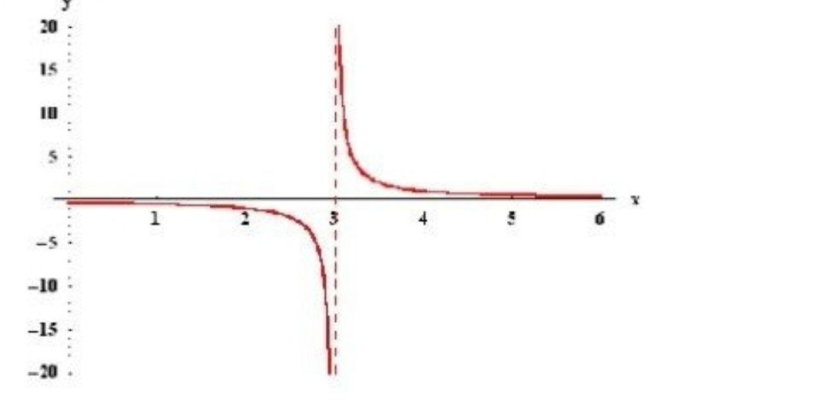
example : consider the function
When x→3, then x-3→0. So and
Note that when x gets closer to 3, then the points on the graph get closer to the (dashed) vertical line x=3. Such a line is called a vertical asymptote. For a given function f(x), there are four cases, in which vertical asymptotes can present themselves:

Slide 12
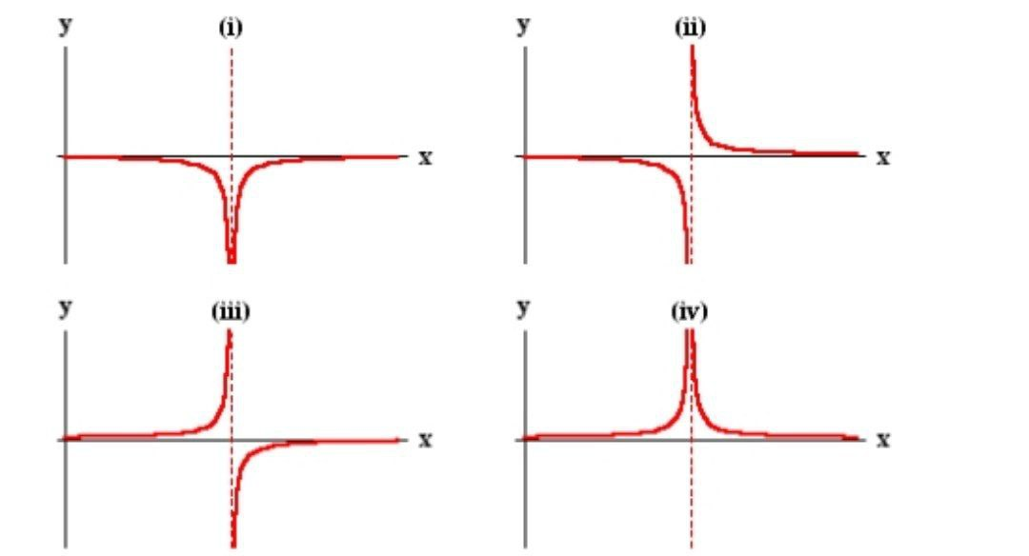
Those assymptotes

Slide 13
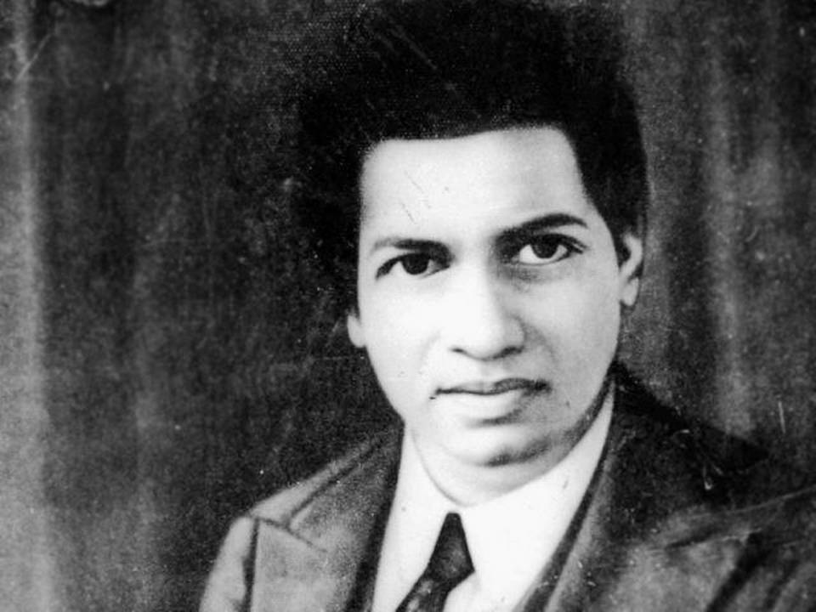
How to measure infinity by SRINIVASA RAMANUJAN

Slide 14
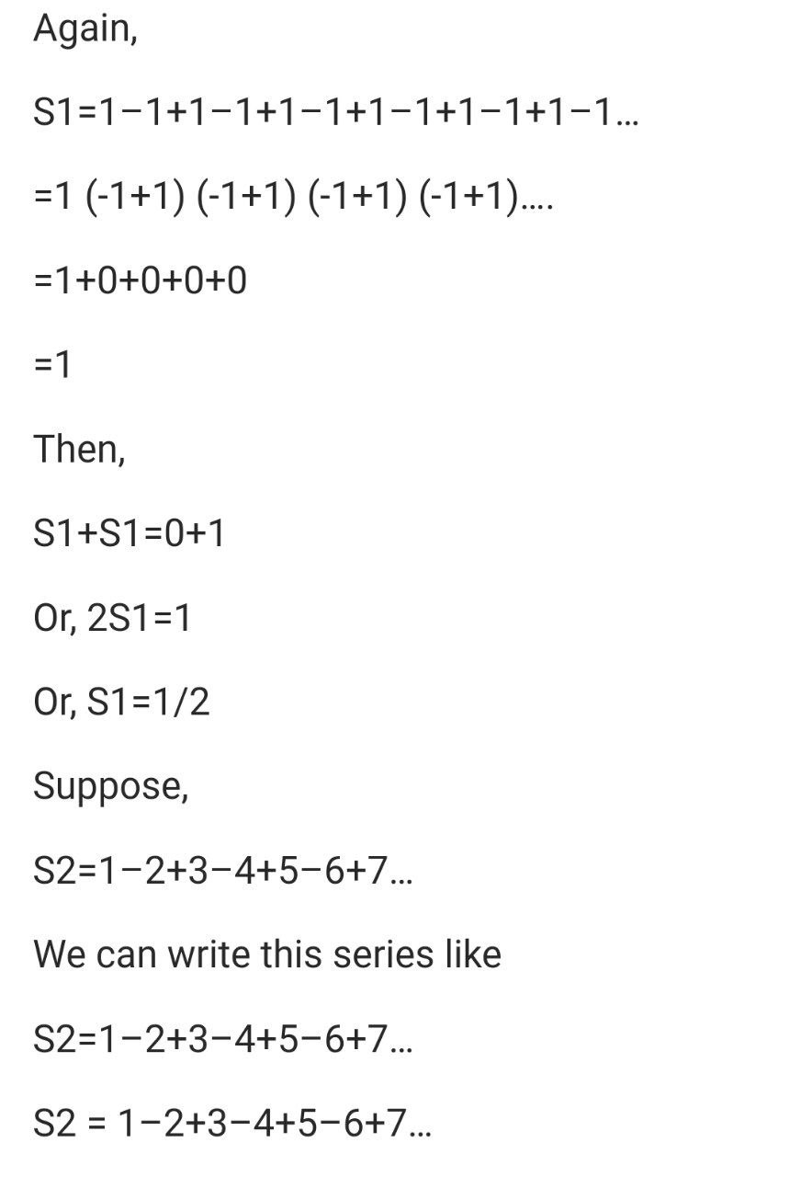
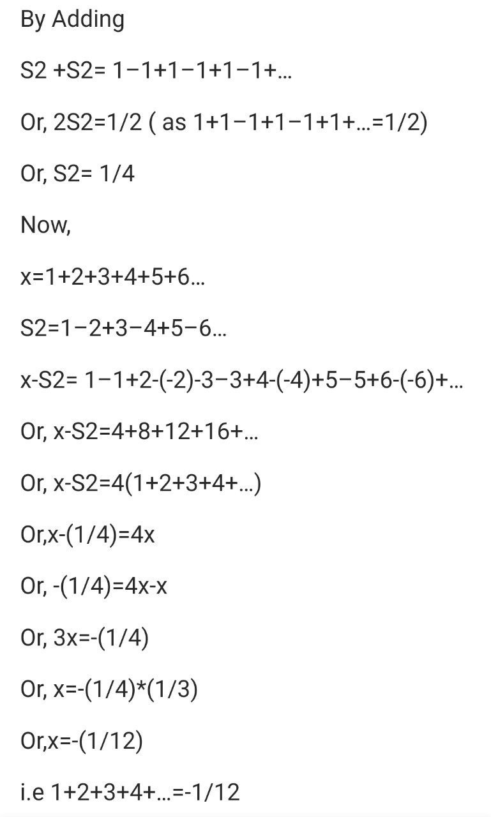

Slide 15
Application of infinity in maths
REAL ANALYSIS
In real analysis,the symbol denotes an unbounded limit.x ∞ means that x grows without bound and x -∞ means value of x decreasing without bound
If f(t) ≥ 0 for every t then means that $\int_{−∞}^{+∞}{f\left(t\right)dt=0}$
f(t) does not bound a finite area from a to b
$\int_{−∞}^{+∞}{f\left(t\right)dt=∞}$ means that the area under f(t) is infinite
s$\int_{−∞}^{+∞}{f\left(t\right)dt=n}$ mean that total area under (t) is finite and equals to n
infinity is also used to describe infinite series
$\sum_{i=0}^{∞}{f\left(i\right)=a}$ means that the sum of the infinite series converges to some real value a

Slide 16
Complex analysis
Complex plane : every complex number can be represented by a point in argand plane Riemann sphere : representation of a complex number by point of a sphere Meromorphic function : a function which has poles as its only singularity in the finite part of the plane is said to be meromorphic Mobius transformation : a maping of the form of s(z)=(az+b)/(cz+d) where a,b,c,d are complex constant ansd s,z are complex variable and ad-bc ≠ 0

Slide 17
Non standard analysis
The original formulation of infinitesimal calculas by Newton and Leibnitz used infinitesimal quantities. In the twentieth century it was shown that this treatment could be put on a rigorous footing through various logic system,including smooth infinitesimal analysis and non standard analysis.

Slide 18
Set theory
GEORG CANTOR developed a system of transfinite numbers,in which the first transfinite cardinal is aleph-null, the cardinality of the set of natural number
Cantor defined two kind of inifinite number -
1. ordinal number (identified by well ordered set)
2. Cardinal number (defined by size of set)

