Slide 1
SEMINAR - 2018
DEPARTMENT OF MATHEMATICS
NAME- SANDIP MONDAL
ROLL NO- 39
TOPIC- CONIC SECTIONS

Slide 2
Conic sections

Slide 3
HISTORY OF CONIC SECTIONS
The gretest progress in the study of conics by the ancient greek is due to APOLLONIUS OF PEGRA [died c.190 BCE ],whose eight volume conic sections or conic summarized and greatly extended exisiting knowledge.

Slide 9
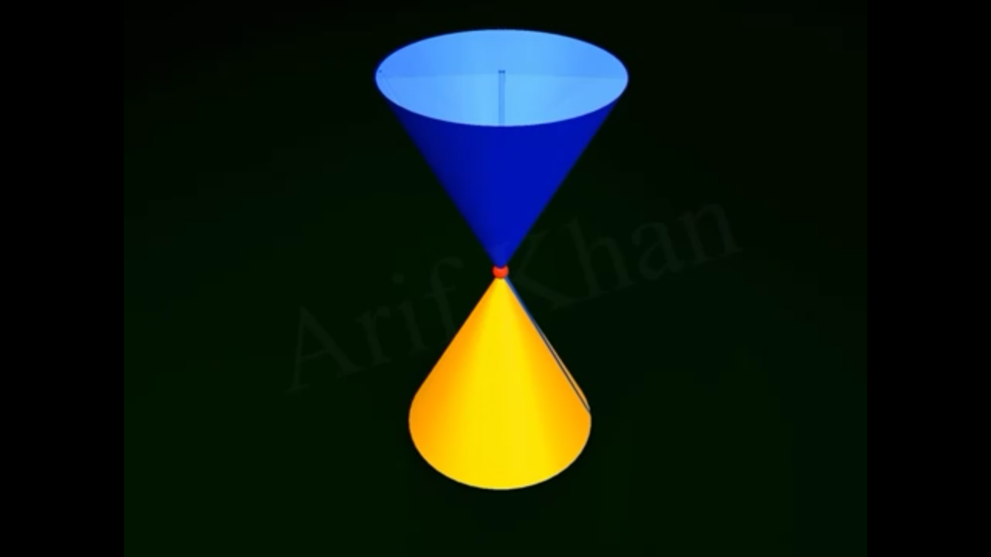

Slide 10
Lower nappe
-----

Slide 12
What is conic sections ?
If a plane cut the double right cercular cone any how we get two dimentional curve of different types is called conic sections

Slide 13
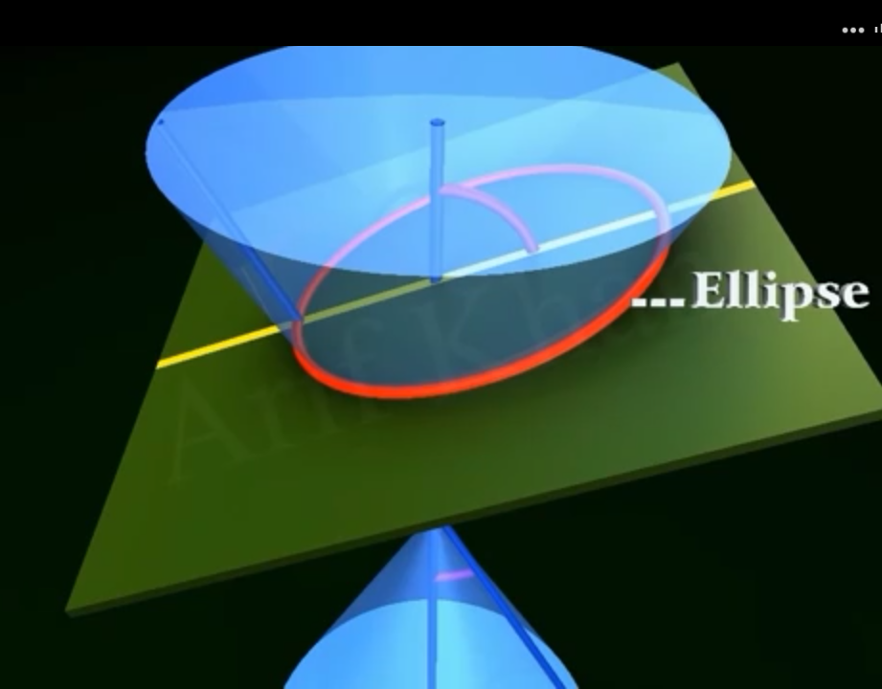

Slide 14
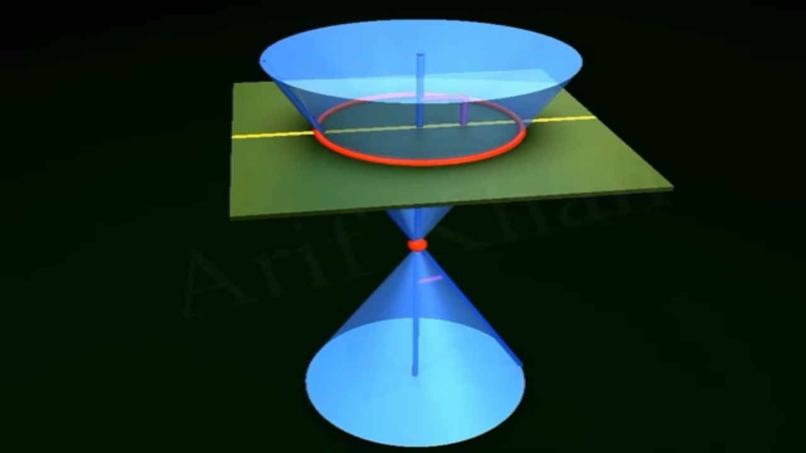

Slide 15
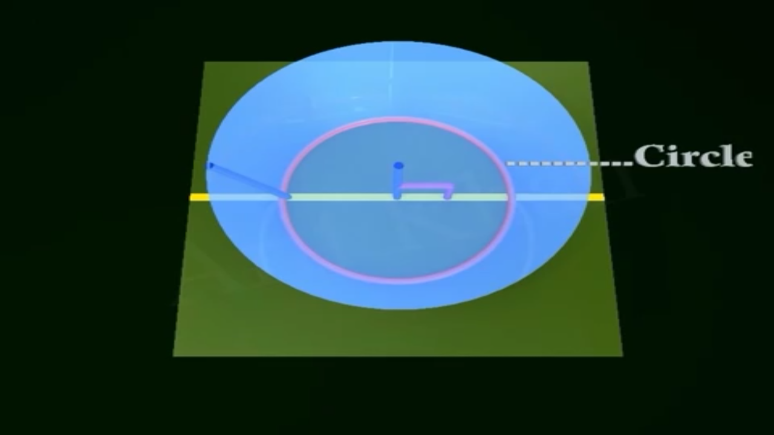

Slide 18
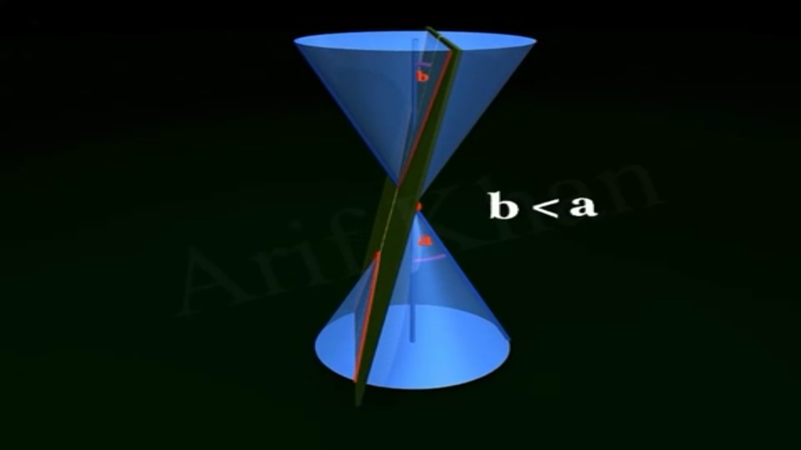

Slide 20
Why they are called bola ?
In previous slides we saw the shape of parabola and hyperbola is like “U” (bola) shape so they are called bola.

Slide 21
DEGENERATE CONICS

Slide 22
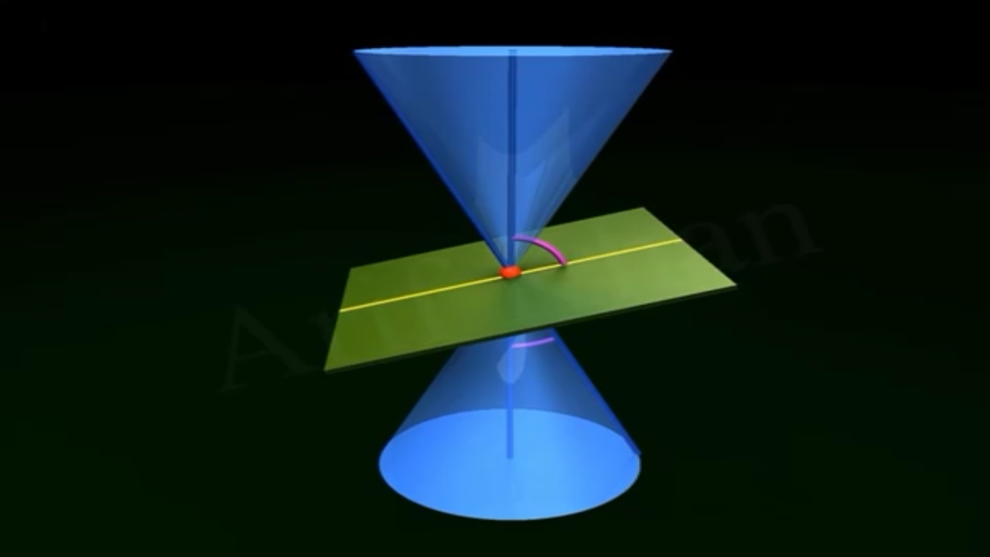
POINT ELLIPSE

Slide 23
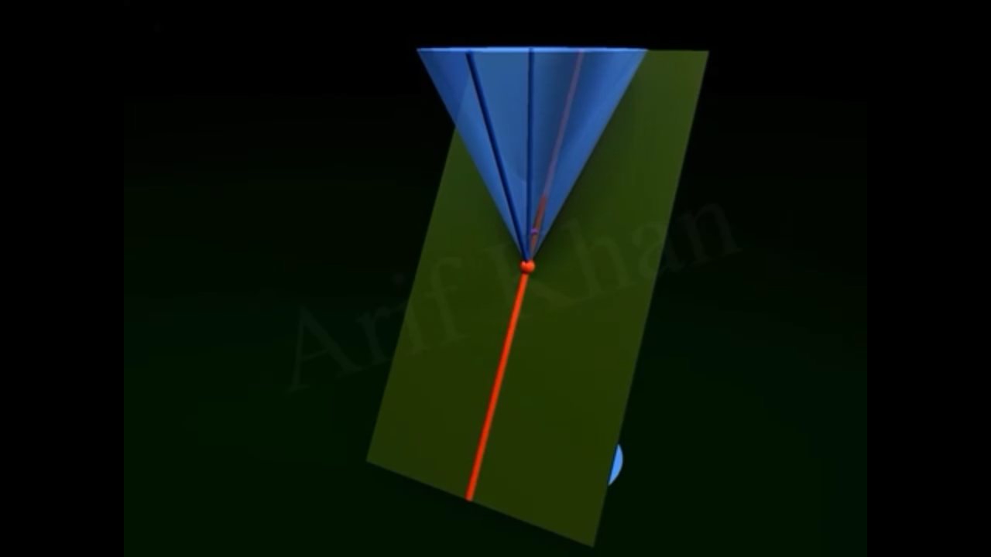
STARIGHT LINE

Slide 24
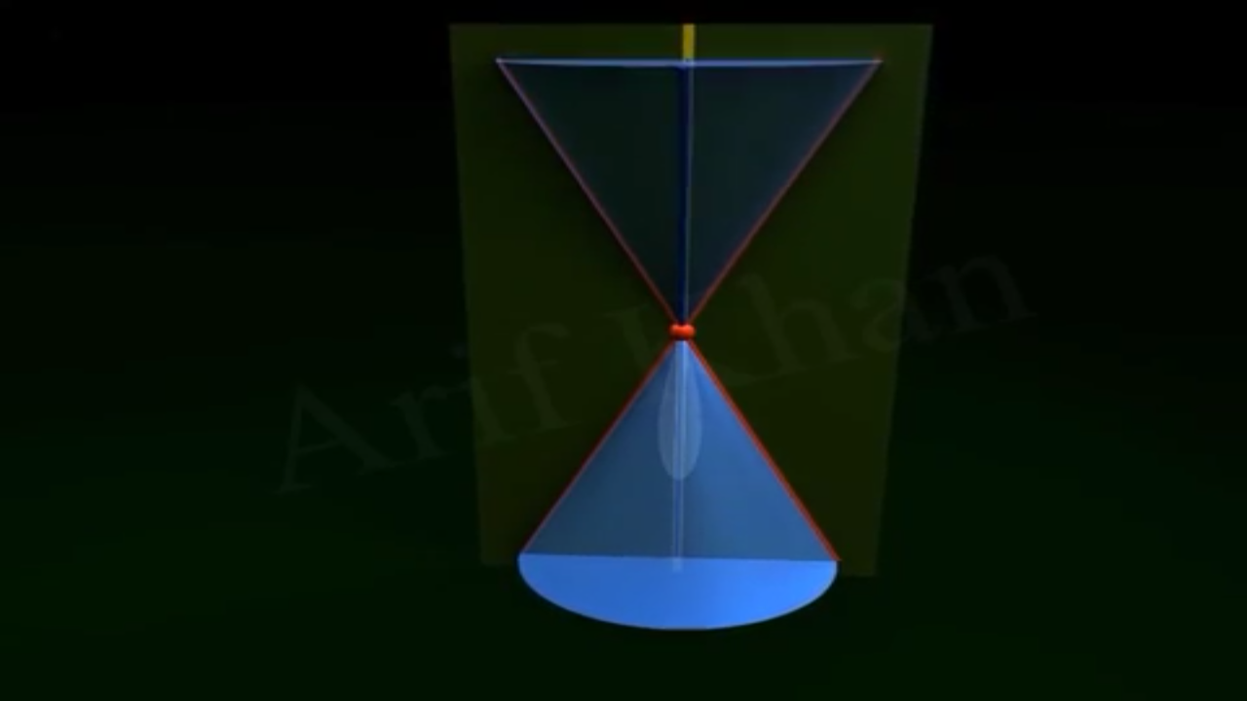
TWO INTERSECTING LINES

Slide 25
Genearl equation of conic sections
Second degree.
Non homogeous.
Represents different types conics.

