Slide 1
SEMINAR 2018
NAME : CHINOY BISAWS
ROLL : 58
DEPARTMENT OF MATHEMATICS
TOPIC : RADIOACTIVE DECAY

Slide 2
WHAT IS RADIOACTIVE DECAY ?
Radioactive decay ( also known as nuclear decay or radioactivity ) is the process by which an atomic nucleus loses energy by emitting radiation , such as alpha particle , beta particle.

Slide 3
DISCOVERY OF RADIOACTIVITY
Radioactivity was discovered in 1896 by the French scientist Henry Becquerel .

Slide 4
UNITS OF RADIOACTIVITY
The SI unit of radioactivity is the becquerel (Bq) .

Slide 5
LAWS OF RADIOACTIVITY
Consider the case of nuclide A that decays into another B by some process . The decay of an unstable nucleus is entirely random and it is impossible to predict when a particular atom will decay . Therefore , given a sample of particular radioisotope , the number of decay –dN expected to occur in a small interval time dt is proportional to the number of atoms presents N , that is

Slide 6
RADIOACTIVE DECAY
Particular radionuclides decay at different rates , so each has its own decay constant

Slide 7
RADIOACTIVE DECAY
At time t=0 the number of atom be N0

Slide 8
RADIOACTIVE DECAY
At t=0, N=N0

Slide 9
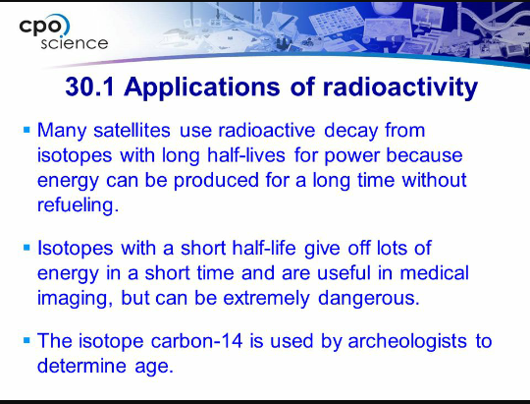
APPLICATIONS OF RADIOACTIVITY

Slide 10
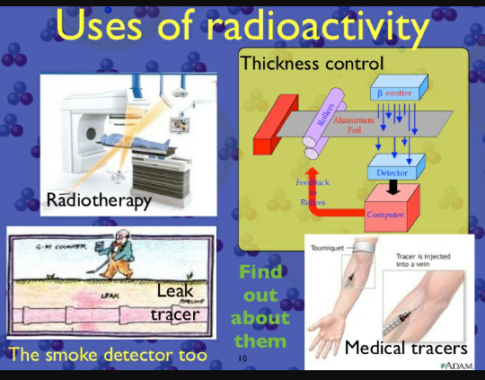
APPLICATIONS OF RADIOACTIVITY

Slide 11

APPLICATIONS OF RADIOACTIVITY

Slide 12
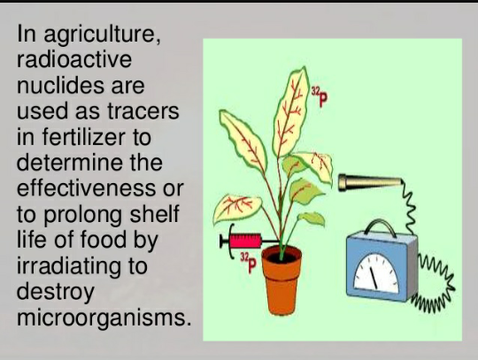
APPLICATIONS OF RADIOACTIVITY

Slide 13
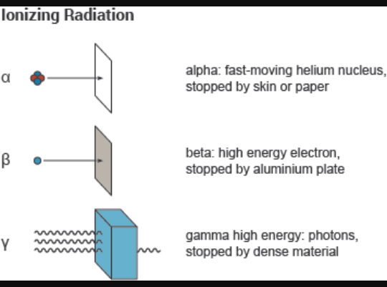
APPLICATIONS OF RADIOACTIVITY

Slide 14
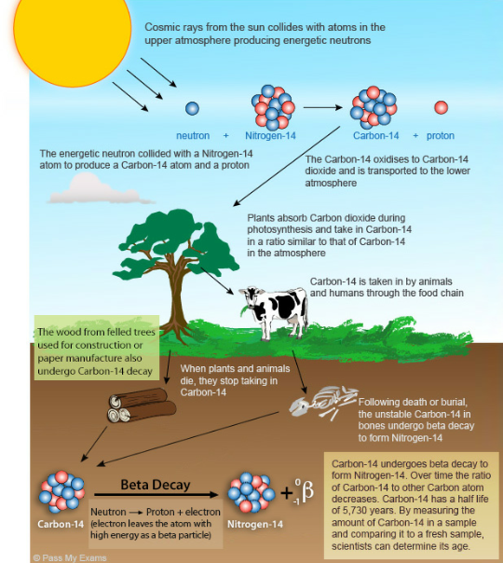
APPLICATIONS OF RADIOACTIVITY

Slide 15
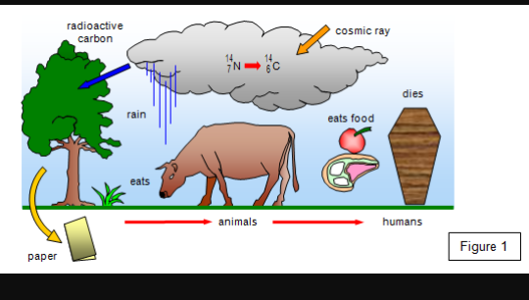
APPLICATIONS OF RADIOACTIVITY

Slide 16
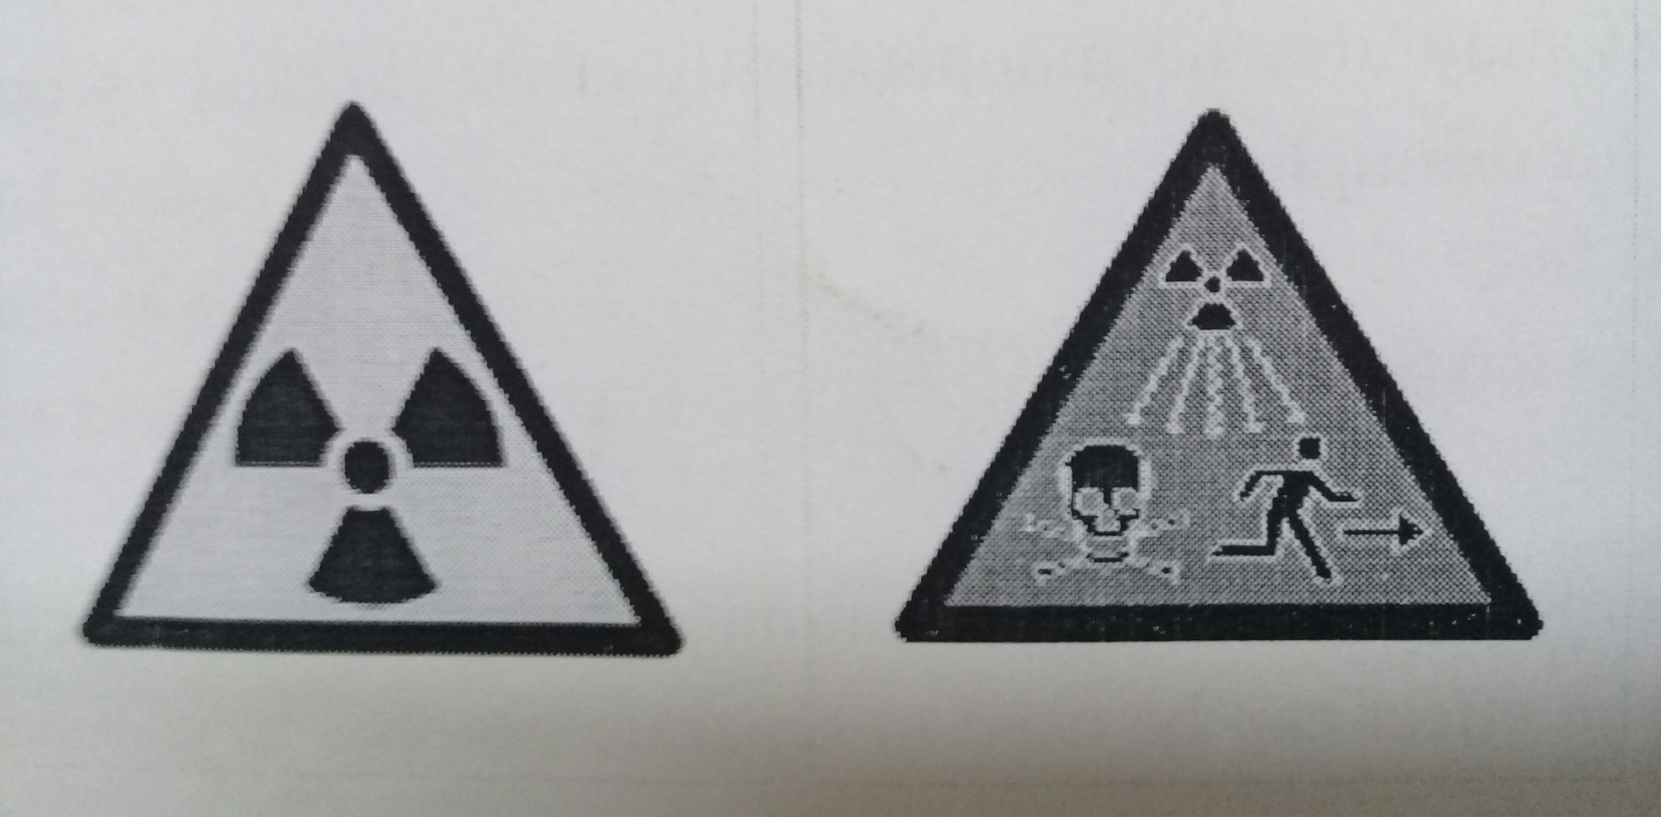
ASSOCIATED HAZARD WARNING SIGNS

Slide 17
THANK YOU
THANK YOU

